Slide 1
Introduction to the Engineering Design Cycle
Solving Everyday Problems Using the Engineering Design Process
Notes:
Introduction to the Engineering Design Cycle Presentation, Solving Everyday Problems Using the Engineering Design Cycle activity, TeachEngineering.org

Slide 2
What is the engineering design process?
A series of steps engineers work through in order to define and solve problems!
Identify
Define
Develop
Evaluate
Test
Optimize
Communicate
Notes:
Engineers usually go through the steps in the order listed, but sometimes they go out of order. That’s why you usually see the engineering design process in a circular shape (see next slide).

Slide 3
How it all fits together
Psst…
Keep an eye out for this symbol throughout the slides!
It tells you which stage of the design process is being covered!
Identify
and
Define
Problems
Develop
and
Evaluate
Solutions
Communicate
Solutions
Test
and
Optimize
Solutions
Notes:
Engineers might start anywhere on the process, and then go to any other step.
They often backtrack to ensure their solutions solve the given problem; for example, after optimizing solutions they might go back to defining the problem before communicating their solutions.

Slide 4
Definitions: Identify and Define the Problem’s Criteria and Constraints
Identify the problem: Identification occurs when someone realizes that a problem exists that needs to be solved.
Define the problem: Definition occurs when someone realizes exactly what the problem is.
For example: Students realizing that they are not getting their work handed back from the teacher is a good example of problem identification. When students realize that they are not getting work handed back because the teacher’s desk is too disorganized, they have begun to identify the problem.
Criteria and Constraints
Criteria are the requirements the solution must meet, such as what it must do.
Constraints are the limitations on the solution, such as a maximum size or budget.
Notes:
Engineers typically start by identifying and defining the problem.
While doing this, they also identify criteria and constraints.
Engineering solutions must meet all criteria and fall within all constraints.

Slide 5
Example: Identify a problem
When you see a problem in the world, imagine how you might be able to solve it through engineering!
So many problems can be solved through engineering.
Students in Mrs. Anderson’s English class are frustrated because they never get their work handed back to them. They can see their grades online, but without getting their work back, they don’t know how to improve!
By noticing that their work is not being handed back, Mrs. Anderson’s students have identified a problem.
Notes:
Let’s look at an example as we go through the engineering design process.

Slide 6
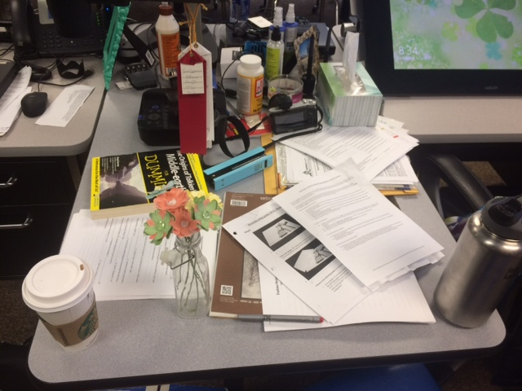
Example: Define/Specify Criteria and Constraints
One way to define this problem is by talking to Mrs. Anderson. When the students ask her why they aren’t getting their work handed back, she apologizes and says that she has trouble keeping her desk organized, and sometimes misplaces assignments after they are graded.
By learning that organization is the reason they are not getting their work handed back, the students have defined the problem.
The students decide to help Mrs. Anderson by building her a desk organizer. Based on their discussion with Mrs. Anderson and their available resources, they develop a list of criteria and constraints for the organizer.
1. Identified criteria:
Must hold 700 papers (100 x seven classes)
Must take up less than 16 x 12 inches surface area
Must be moveable
2. Identified constraints:
Must cost less than $5
Notes:
Now that the students have identified the problem, they must define the problem and identify the criteria and constraints for their solutions.
Note that the students talked with Mrs. Anderson about the problem when developing their list of criteria and constraints. Engineers talk with their clients and experts when developing new roads, medical equipment, and even rockets. Communication is important in engineering.
///
Image source (photo of a teacher’s desk) 2016 Christina M. Sias, Utah State University

Slide 7
Definitions: Develop and Evaluate Ideas
Engineers develop ideas by thinking of possible solutions to the problem.
Brainstorming!
Engineers evaluate ideas by considering the pros and cons of the possible solutions.
Notes:
The next step in the engineering design process is to develop and evaluate ideas. Engineers come up with many ideas that could be solutions to the problem/challenge. At this stage, no idea is too crazy!
In the evaluate ideas step, engineers consider the pros and cons of the possible solutions, and check to see if the solutions meet all the criteria and abide by all the constraints. For example, designing an underpass for students to walk safely under a road on their way to school would solve the problem of “students have trouble crossing the road due to too many cars,” but it would be very expensive and take a long time to build. Another idea, “to install a traffic light,” would solve the problem and stay within the budget.

Slide 8
Example: Develop ideas
What possible solutions can you come up with to Mrs. Anderson’s problem?
Mrs. Anderson’s students talked to each other and came up with a few different ideas, including a stack of baskets or drawers, and a box to organize file folders.
Notes:
(Let students discuss possible solutions other than the ones listed in their groups.
Then have each group share its ideas.)

Slide 9
Example: Evaluate Ideas
Building a stack of shelves or baskets is too expensive. The students realized this when they began looking at material prices. Since it would cost more than $5, this solution did not meet the constraints.
Students realized that they could afford to build a file folder organizer, that it would be easy to move, and would not take up much room on Mrs. Anderson’s desk.
Based on their evaluation of their ideas, the students realized that the file folder organizer was a good solution to the problem.
Notes:
Now, Mrs. Anderson’s students evaluate their ideas and think about the criteria and constraints.

Slide 10
Definitions: test and optimize solutions
Engineers test solutions by trying them out to see how well they work.
Engineers optimize solutions by paying attention to the details of their tests, and thinking of ways the design could be better.
Notes:
After choosing the best solution, engineers test and optimize their solutions.
The testing shows what works and what doesn’t.
Optimization fixes the problems and makes the solution even better.

Slide 11
Example: Test solutions
Using materials and tools given to them by the school’s woodshop teacher, the students designed a small box to hold Mrs. Anderson’s file folders. They gave it to her to try it out and see what she thought.
The first draft is a plain wooden box designed to hold file folders upright.
It is very wide and the sides are short; when Mrs. Anderson puts the files in, they flop over.
Notes:
Mrs. Anderson’s students begin to test their ideas.
They build a simple prototype and let Mrs. Anderson test it.
What worked: The box is small enough to fit on Mrs. Anderson’s desk.
What didn’t work: The files flop over when placed inside.
What step in the engineering design process will Mrs. Anderson’s students do next? (Let students answer. The correct answer is: optimize the solution.)

Slide 12
Example: Optimize the solution
With feedback from Mrs. Anderson, the students realize that they need to redesign the box so that it holds file folders better. They made some changes:
The revised design has a raised back to support the height of the files and papers
The students also added a board across the center to help Mrs. Anderson organize her files.
Notes:
Engineers modify their initial designs and make new prototypes that are even better. Notice the new raised back and center board.
If this design still had problems, what would Mrs. Anderson’s students do? (Possible answers: optimize the solution and test it again, brainstorm new modifications and solutions, etc.)

Slide 13
Definition: Communicate Solutions
Engineers communicate their designs when they explain to others how they were designed, why they are useful, and how others might use them.
Notes:
Next, engineers communicate their solutions. That way, others with the same problem can solve it. For example, if an engineering team developed a new way to filter water, they would explain their design so that others understand it and so that everyone could have safe drinking water.

Slide 14
Example: Communicate Solutions
Mrs. Anderson loves her new desk organizer!
It was so easy and inexpensive to make that the students wondered why the school didn’t provide them to all the teachers. They wanted to make more organizers for the rest of the teachers, but couldn’t afford to buy all of the supplies on their own.
They created a presentation for the school principal in which they explained why their organizer was useful to teachers, and asked for the materials to build more for the rest of the faculty. The principal was impressed by the design and agreed to provide the materials.
Notes:
Mrs. Anderson’s students realized that other teachers might be able to benefit from a desk organizer, so they shared the solution.

Slide 15
Some famous people who used the engineering design process
Notes:
Using the engineering design process is not limited to students in a classroom!
Perhaps you will recognize these famous people who illustrate successful examples of using the steps of the engineering design process.

Slide 16
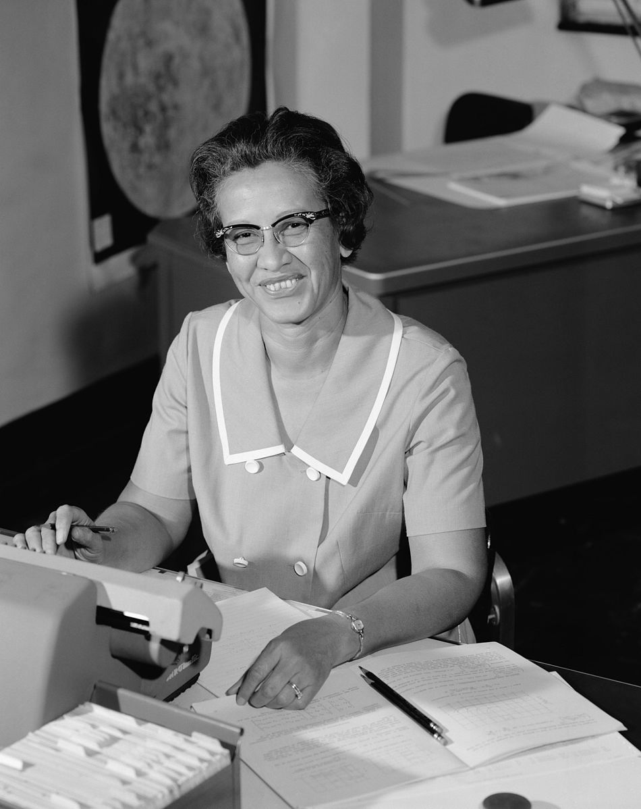
Katherine Johnson
Katherine Johnson was sometimes called a “human computer” because she performed complex mathematical calculations for NASA to help people explore space!
You might have seen her featured in the movie, Hidden Figures.
She is responsible for identifying and working within mathematical and technological constraints.
Her math was so accurate that John Glenn refused to launch until the computer’s calculations had been tested against Johnson’s math.
Katherine Johnson at NASA in 1966.
Notes:
Using the engineering design process took people to the moon!
Katherine Johnson kept constraints in mind when she worked on calculations for NASA.
(John Glenn was the first American astronaut to orbit the Earth. This orbit was the mission where Glenn requested that Johnson check the computer calculations. The mission occurred in 1962.)
///
Image source:
(photo of Katherine Johnson) 1966 Adam Cuerden, Wikimedia Commons (public domain) https://commons.wikimedia.org/wiki/File:Katherine_Johnson_at_NASA,_in_1966.jpg
Information resource:
Shetterly, Margot Lee. (November 22, 2016) Katherine Johnson Biography. NASA. Accessed May 21, 2017. https://www.nasa.gov/content/katherine-johnson-biography

Slide 17
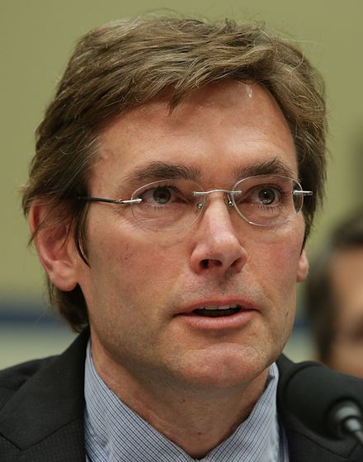
Lee Anne Walters and Marc Edwards
When the city of Flint, MI, changed its water source, big problems began.
The city identified the problem when it detected fecal coliform bacterium in the water. Lee Ann Walters, a local mother, also identified high levels of lead in her water. She noticed a problem when her twins broke out with red bumps after bath time.
Walters teamed up with Marc Edwards, an engineering professor and expert in lead corrosion. After testing, he reported that the water in one in six Flint homes contained twice the usual amount of lead.
The city identified the criteria and constraints when they realized that finding a new water source would cost more money than they had to spend.
One solution was to install water filters in 400 homes, which would ensure safe drinking water in those homes and stay within the budget constraints. But when the filters were tested, 52% of them were found to be defective.
Because they won a lawsuit, the city now has the funds it needs to replace the pipes. They should be installed by 2020.
Engineer Marc Edwards studied the water supply.
Dirty and clean water.
Notes:
Lead is harmful to human health and unfortunately is found in many old pipes that were installed before the health effects were really understood. Using a different water source caused lead from the pipes to leach into people’s tap water.
Notice the many engineering design process steps: identifying the problem, finding criteria and constraints, testing a solution, and revising the solution.
After testing the filter solution, they found that 52% were defective! Did the city choose to optimize this solution? (Answer: No, they chose a different solution: replacing the pipes.)
Why didn’t the city choose to replace the pipes as its initial solution? (Possible answers include: too expensive, but later they obtained the money to do this; would be a lot of work, easier to put in filters, digging up pipes would get in peoples’ way, etc.)
///
Image sources:
(photo of Marc Edwards) 2016 House Committee on Oversight and Government Reform, Wikimedia Commons (public domain)
https://commons.wikimedia.org/wiki/File:Marc_Edwards_2016.jpg
(photo of glass vials of clean and dirty water) Alena Brozova, Dreamstime (royalty free stock image) https://www.dreamstime.com/stock-images-carafe-clean-dirty-water-image7737604
Information resources:
Adams, M., & Tuel, J. (2016) Fighting for Flint. Accessed May 23, 2017. http://www.vtmag.vt.edu/spring16/fighting-for-flint.html
Flint Water Crisis Fast Facts. (April 10, 2017) May 23, 2017. http://www.cnn.com/2016/03/04/us/flint-water-crisis- fast-facts/index.html
Lurie, J. (January 21, 2016) Meet the mom who helped expose Flint's toxic water nightmare. May 23, 2017. http://www.motherjones.com/politics/2016/01/mother-exposed-flint-lead-contamination-water-crisis

Slide 18
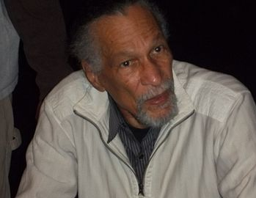
James E. West
Inventor James West was born in Virginia, and although he had a knack for science and engineering, his family discouraged him from attending college because finding professional work was difficult for African Americans at that time.
Nevertheless, West excelled in college and after graduating took a job at Bell Laboratories.
Bell Laboratories noticed that the microphones in telephones weren’t sensitive enough, so they asked West to design a better microphone.
One major constraint of this project was that the microphone needed to be small enough to fit into a telephone.
West, along with his partner, developed the foil-electret microphone in 1964, a small microphone technology that is still used in about 90% of the microphones made today.
Notes:
(Read through the slide or let students read on their own. Lead students in discussion of the following questions.)
Can you identify the problem? What was it? (Answer: Microphones weren’t sensitive enough.)
What is a constraint of the project? (Answer: The microphones needed to be small enough to fit into a telephone.)
What solution did James West and his partner Gerhard Sessler develop? (Answer: The foil-electret microphone.)
Many microphones today are based on West and Sessler’s original design. They are used in devices like telephones, baby monitors and hearing aids.
///
Image source:
(Photo of James West) 2011, Nanoman657, Wikimedia Commons CC BY-SA 3.0
https://en.wikipedia.org/wiki/James_Edward_Maceo_West#/media/File:James_West.JPG
Information resource:
Abdul-Jabbar, K., Obstfeld, R., Boos, B., & Ford, A. What color is my world?: The lost history of African-American inventors. Somerville, MA: Candlewick Press, 2013.

Slide 19
Jorge Odón
Jorge Odon is a 59-year-old Argentinian mechanic who thought of a lifesaving invention during a dream.
He identified the problem—that forceps can damage babies’ skulls during difficult births.
He imagined that a vacuum-like device might be a safer alternative.
He tested his idea by building a prototype and gently suctioning his daughter’s doll out of a bottle.
The device is now being manufactured by a medical supply company and will be available for use all around the world. Its low cost means that people in poor countries will have access to this important medical innovation.
Notes:
Anyone can be an engineer and develop solutions to problems.
Jorge Odon thought of his solution during a dream!
As you’ve seen, the engineering design process has been used by engineers to develop solutions to many real-world problems.
///
Information resource:
McNeil, Donald G. , Jr. (November 13, 2013) Car Mechanic Dreams Up a Tool to Ease Births. May 23, 2017. http://www.nytimes.com/2013/11/14/health/new-tool-to-ease-difficult-births-a-plastic-bag.html

