Slide 1
Engineering a Ping Pong Ball Retriever

Slide 2
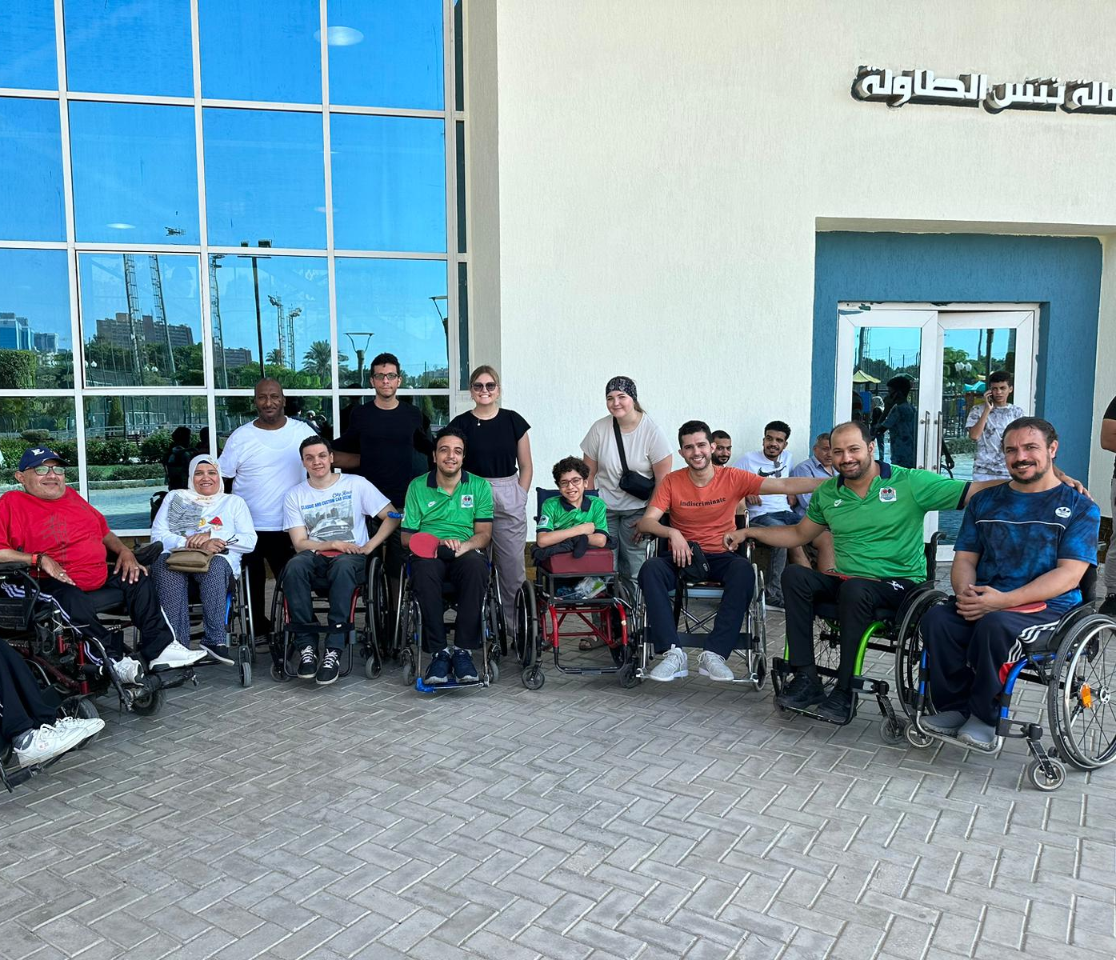
Engineers Needed!
A wheelchair table tennis team in Egypt needs your help! The team practices multiple times a week and uses a tub of ping pong balls to practice. However, the team struggles to pick up the balls after practice. The team does have some able-bodied people to help, but the team would love a device that they could easily use from their wheelchairs to pick up the ping pong balls.
#8d64aa
#f8a81b

Slide 3
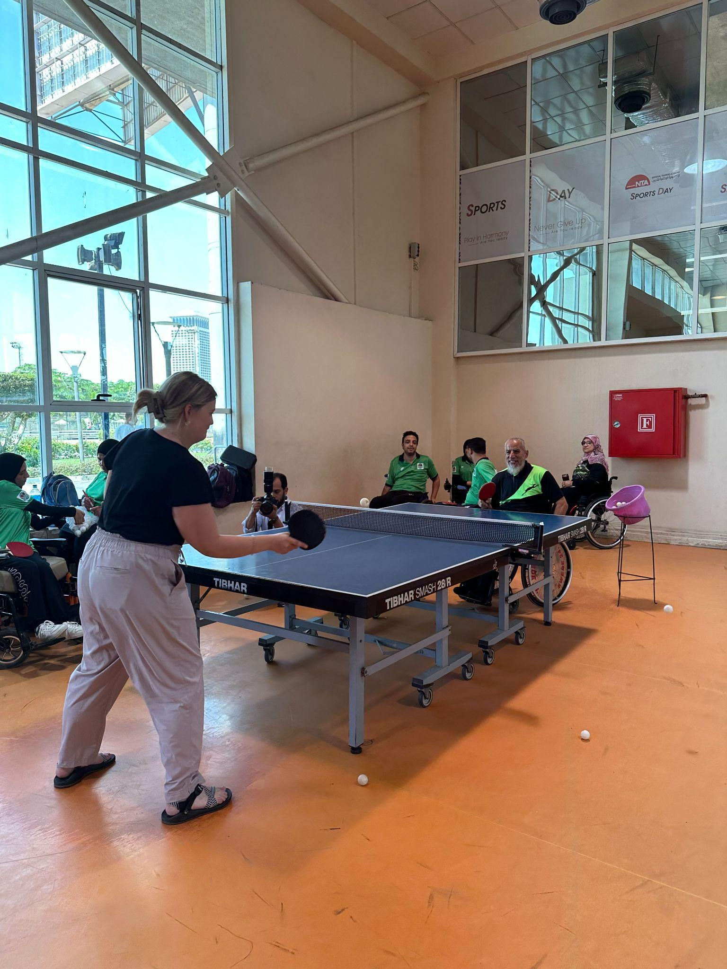
Your Job!
Here is where you come in… Your job is to use common, reusable materials found in Egypt to create a prototype to pick up as many ping pong balls at one time as possible. Your device must be able to be used without putting your hand lower than the seat of your chair and must be built with the user in mind.
At the end of the build, your group will pitch your prototype to the company, so be sure to meet the requirements listed above.

Slide 5
Egypt: Background Information
Video 1: Tackling plastic waste in Egypt – DW – 11/10/2022
While watching the video above, write down some common materials that are used in Egypt in the research box on your worksheet.
Article 1: Learning and Earning in Zabaleen
Check out the article on page 41 and write down at least two positive things that are going on in Zabaleen.
Notes:
Video 1: Tackling Plastic Waste in Egypt
What are the most common materials thrown away in Egypt? Single-use plastic products- bags bottles, takeout containers
What did they create from the plastic waste? Bricks
Have you seen similar issues in the United States? Yes, many waterways have trash. Some organizations do similar cleanups and recycling projects.
What do you do in your homes to reduce the use of trash? Recycle, reduce the use of single-use plastics.
Article 1: Learning and Earning in Zabaleen
What positives are happening in Garbage City? SOY’s core project is the Recycling School for Boys, which aims to enhance the diffusion of pracitical knowledge both to improve qualification levels and to empower the community in the recycling business.

Slide 6
List of Available Supplies
plastic bottles
plastic bags
takeout containers (plastic plates/tin foil pans)
aluminum foil
straws
rubber bands
tape
plastic silverware
cardboard boxes
scissors
plastic cups
string
anything else you bring in/get approved

Slide 7
Using the supplies listed on the previous slide, imagine (sketch out) at least TWO different designs for your prototype on your case file paper.
#6091ba

Slide 8
Teamwork Makes the Dream Work!
Get together with your engineering team and plan (sketch) ONE prototype that you think will be the most successful based off of all of your individual sketches.
#6091ba
*See your teacher when ALL group members have a sketch drawn in the plan box.
Notes:
Assign teams - can be done randomly or specifically. Initial the corner of the “plan” box on students’ papers so that students are staying on task and have approval before obtaining supplies.

Slide 9
Get to Work!
Work together with your group to create your first prototype. Make sure you are meeting the needs and constraints you listed at the beginning of the process.
#6091ba

Slide 10
Time To Test!
With your teacher’s approval, pick up a tub of ping pong balls and get started testing and improving.
#6091ba
Notes:
*Be sure to go to Slide 11 and show the students the rubric before letting them get any supplies.

Slide 11
 | Expectation Not Met | Expectation Partially Met | Expectation Met | Score
Explain how you used the engineering design process | 0 | 1 | 2
Picks up balls | 0 | 1 | 2
Users’ needs considered *Remember your hand cannot be lower than the seat of your chair. | 0 | 1 | 2
Use of common Egyptian materials | 0 | 1 | 2
Aligns to at least 2 SDG goals | 0 | 1 | 2
#6091ba
Total Score: ______/ 10
But what is an SDG goal?..

Slide 12
Follow the link to research the Sustainable Development Goals and pick two goals to incorporate into your prototype.
#6091ba
https://www.undp.org/sustainable-development-goals

