Slide 1
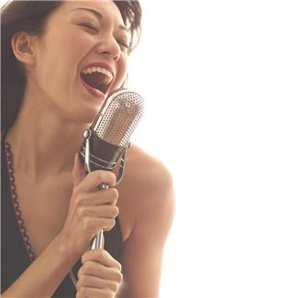
How Does a Sound Sensor Work?
Notes:
How Does a Sound Sensor Work? Presentation > TeachEngineering.org

Slide 2
Sound Sensor Pre-Quiz
How do humans sense sound? What is the sound sensor in the human body?
Provide an example “stimulus-sensor-coordinator-effector-response” framework using the human ear.
Give examples of sensors in engineering systems that are similar to the human sound sensor.

Slide 3
Sound Sensor Pre-Quiz Answers
How do humans sense sound? What is the sound sensor in the human body?
We have two ears that enable us to hear sounds.
Provide an example of “stimulus-sensor-coordinator-effector-response” framework using the human ear.
Example: sound waves from thunder > human ear > human brain > leg muscles > run for shelter
Give examples of sensors in engineering systems that are similar to human sound sensor.
Examples: LEGO sound sensor; microphones in phones, computers, karaoke machines, etc.

Slide 4
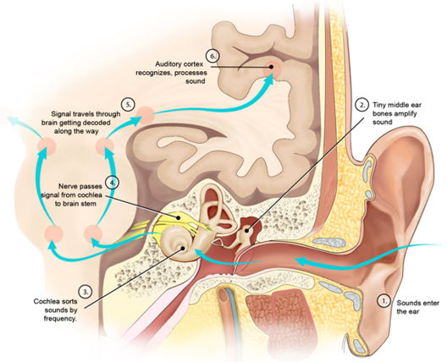
Human Ear Anatomy

Slide 5
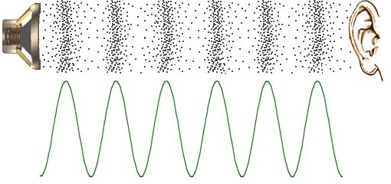
Human Ear and Sound Sensor
How do we hear a song or any sounds?
Pressure vibrations in the air are perceived as sound. Example: A speaker causes air to vibrate in the pattern (wave) shown in the diagram below, and our ears pick this up as sound.
From your outer ear, these vibrations pass through your ear canal and reach the middle ear.
In the middle ear, the vibrations hit the ear drum (tymphanic membrane) and cause it to vibrate as well.

Slide 6
Human Ear and Sound Sensor
The ear drum vibrates three small bones in the ear in turn, the hammer, anvil and stirrup (ossicles).
Then the stirrup passes these vibrations to a coiled tube in the inner ear called the cochlea.
The cochlea is filled with fluid and hair-like small nerve endings called “cilia,” which pass the information to the auditory nerve.
The auditory nerve carries the signal to the brain.
Watch the “How the Ear Works” video: (2:02 minutes)
http://www.youtube.com/watch?v=-bKy02f1pD4&feature=youtu.be&src_vid=ahCbGjasm_E&feature=iv&annotation_id=annotation_1543119125

Slide 7
Review: From Stimulus to Response
stimulus > sensor > coordinator > effector > response
sound > ear > nervous system > muscle > movement
From the sequence of steps above, this is what happens when you hear a loud noise such as thunder:
The stimulus is sound, the sensor is your ear that senses it and relays it through the auditory nerve to your brain, which is the coordinator.
The coordinator makes the decision of how to react, and then commands the leg muscles (the effector) to run for safety.
So, we go from stimulus (sound) to response (using muscles to get to safety).
Do This: Sketch out the stimulus-to-response sequence for a robot sound sensor. Identify all the components, as in the example listed above.
(Example answer on slide 18)

Slide 8
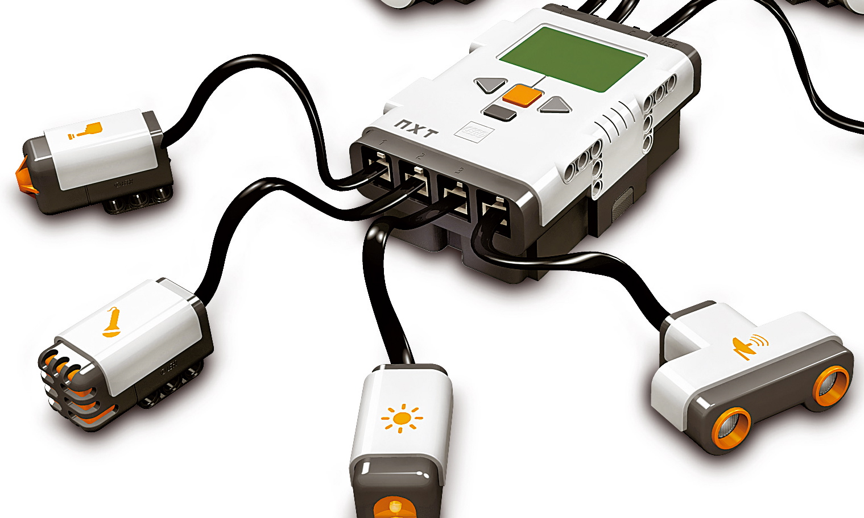
Review: Robot Sensors
(As stated in an earlier activity,) robot sensors:
Gather information from the surroundings and send it to the computer brick
Robot sensors can only be used if the robot’s program asks for information from them!
Similarly, the robot can only act on information from the sensors if its program tells it to do so!
How do sensors send signals to the LEGO computer (brick)?
The sensors send information through wires (similar to the nervous system in your body) that connect them to the LEGO brick, which uses the information if its program requires it.

Slide 9
What is sound and how can you sense it?
What is sound?
Sound is made of sound waves or air vibrations.
Louder sounds produce larger vibrations.
Higher pitch sounds produce more frequent vibrations.
The sound sensor has a thin piece of material called a diaphragm that vibrates when hit by sound waves (similar to how your eardrum vibrates when hearing sound).
The vibration of the diaphragm is converted by the sensor into an electrical signal that is sent to the LEGO brick, which knows that a sound has been heard.

Slide 10
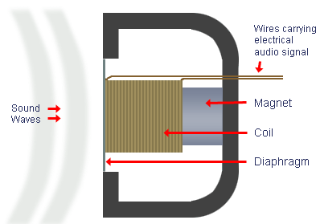
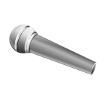
What is a microphone?
The LEGO sensor is similar to a microphone. A microphone converts sound energy to electrical energy.
The microphone (on the left) has a diaphragm that moves with sound. This motion is converted to electricity using a magnet and coil (as you will learn later in physics and engineering).

Slide 11
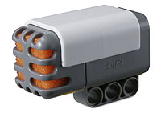
LEGO Sound Sensor = a Simple Microphone
A microphone can sense sound level and sound frequency.
The LEGO sound sensor is similar to a microphone, in that it can sense sound level, but it cannot detect sound frequency.
The LEGO sound sensor provides a value between 0 and 100% depending on the level.

Slide 12
How Are Sound Sensors Made?
In engineering, the term “auditory” refers to something related to sound, so sound sensors are also called auditory sensors.
The LEGO sound sensor has a diaphragm (under the yellow/orange foam ), similar to the microphone used for a karaoke machine.
The air pressure vibrations make the diaphragm move, and this diaphragm motion is sensed and converted into electrical signals.

Slide 13
Sound Level (dB) and LEGO Brick Readings
Sound sensors also tell you the sound “level.”
The best known example of a sensor that can measure the sound level is the decibel meter, but a baby alarm can also register the sound level. If a baby cries too loud it sounds the “alarm” in the parents’ baby intercom so they hear the baby cry.
We measure the sound level in decibels (dB). When you talk to a person in a normal voice, the sound level is ~40 to 60 dB. When you make a lot of noise, the membrane of the microphone moves much more and you measure a level of sound that is higher than 90 dB.
The LEGO sound sensor detects the decibel level. The sound sensor can measure sound pressure levels up to 90 dB, about the level of a lawnmower. Sound sensor readings on the LEGO brick are displayed in the percentage (%) of sound the sensor is capable of reading. The sound level of this sensor is represented in %.
< 5 % quiet room
5-10% talking at a distance from the sensor
10-30% talking into the sensor / playing background music
30-100% shouting into the sensor / very loud music

Slide 14
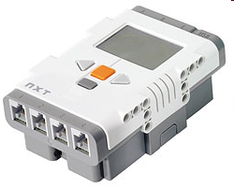
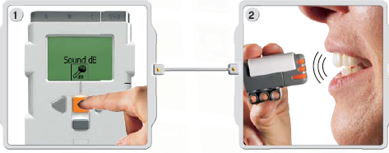
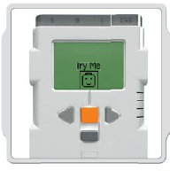
Let’s Experiment
How Does the LEGO brick/computer read the signal from the sound sensor?
Do This: Attach the LEGO sound sensor to the LEGO brick as shown below. ⬇
Then use the VIEW command and speak into the sensor or make different sounds.
Pressing the button closes the circuit and sends a signal to the computer.
Look at the display as it shows % values for different sounds.
After this, check the working of the sound sensor using the “Try Me” option. ➔
Note your observations on a separate sheet of paper and show to the teacher.

Slide 15
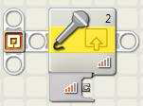
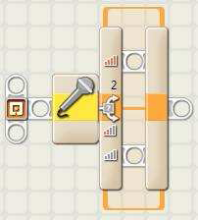
Sound Level (dB) and LEGO Brick Readings
The LEGO sound sensor can be used in three different “modes.”
This block measures the sound level and then sends it as a logical signal (true/false) via the wire. If the sound level is above a certain limit, then the “true” signal is sent. If it is under a certain limit it sends a “false” signal.
Another way is the “Wait” block, which lets you make the LEGO robot wait until the sound sensor registers the required sound level. Once it hears a loud enough sound, the robot continues to the next task.
Yet another way is the “Switch” block. The LEGO robot performs one task when it does not hear the sound signal and a different task when it does. This is a true/false function.
For example you’re now able to make the robot move forward as long as the sound sensor doesn’t register 50% of its maximum sound level. When it does reach this sound level it performs another task, such as driving around in circles until the sound drops below 50% again.
Notes:
Three different ways to program the LEGO sound sensor using its programming block options.
Students will need to know this information in order to conduct the associated activity.

Slide 16
Sound Sensor Post-Quiz
How do humans sense sound? What is the sound sensor in the human body?
Provide an example “stimulus-sensor-coordinator-effector-response” framework using the human ear.
Give examples of sensors in engineering systems that are similar to the human sound sensor.

Slide 17
Sound Sensor Post-Quiz Answers
How do humans sense sound? What is the sound sensor in the human body?
We have two ears that enable us to hear sounds.
Provide an example “stimulus-sensor-coordinator-effector-response” framework using the human ear.
Example: sound waves from thunder > human ear > human brain > leg muscles > run for shelter
Give examples of sensors in engineering systems that are similar to human sound sensor.
Examples: LEGO sound sensor; microphones in phones, computers, karaoke machines, etc.

Slide 18
Answer for Slide 7 Question
stimulus > sensor > coordinator > effector > response
hand clap > sound sensor > brick > motor > stop moving

Slide 19
Vocabulary
auditory: Related to hearing.
sensor: A device that converts one type of signal to another; for instance, the speedometer in a car collects physical data and calculates and displays the speed the car is moving.
transducer: Another term for a sensor (see above).
ultrasonic: A sound of a frequency that humans cannot hear, but dogs and bats can.

Slide 20
Image Sources
Slide 1: photo of woman singing with microphone; source: Microsoft® clipart: http://office.microsoft.com/en-us/images/results.aspx?qu=singing&ex=1#ai:MP900409066|mt:2|
Slide 4: Hearing anatomy & mechanics diagram; source: 2006, Zina Deretsky, National Science Foundation, Wikimedia Commons: http://commons.wikimedia.org/wiki/File:Hearing_mechanics.jpg
Slide 5: sound waves; source: author
Slide 7: photo of lightning in the sky; source: Microsoft® clipart: http://office.microsoft.com/en-us/images/results.aspx?qu=thunder&ex=1#ai:MP900400460|
Slides 8, 11, 12, 14: LEGO device images; LEGO MINDSTORMS NXT User’s Guide
Slide 10, 11: microphone; source: Microsoft® clipart: http://office.microsoft.com/en-us/images/results.aspx?qu=microphone&ex=1#ai:MC900433836|
Slide 10: Cross section of dynamic microphone; source: Total Venue: http://www.totalvenue.com.au/articles/microphones/microphones.html
Slide 15: screen captures; source: author

