Slide 1
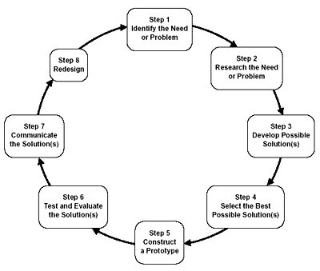
Steps of the Engineering Design Process
Notes:
Sensory Toys Make Sense! Activity > TeachEngineering.org
EDP graphic source: http://www.doe.mass.edu/frameworks/scitech/2001/standards/strand42.gif

Slide 2
Sensory Toy Project
Design Criteria
Problem Statement
Design a sensory integration toy for a child with developmental disabilities.
Constraints
The device must:
be safe
be durable
cost less than $10
weigh less than 2 pounds
be completed in 2 weeks
not be messy or make a mess
target 2 of the following senses: visual, auditory or tactile
Notes:
Sensory toy project design criteria
For engineers, constraints are the limitations and requirements that must be considered when designing a workable solution to a problem.
The problem statement is step 1 of the engineering design process: identify the need or problem

Slide 3
Sensory Integration Discussion Questions
What is the most important sentence in the first paragraph?
Does sensory integration remain the same throughout your life?
What is one disadvantage that may occur for people who have a problem with sensory integration?
Notes:
After students have read the Sensory Integration Reading, lead a discussion prompted by these questions

