Slide 1
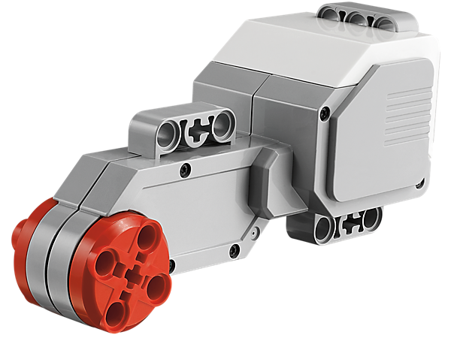
Master Driver
Notes:
Master Driver Presentation > TeachEngineering.org

Slide 2
Master Driver Activity
Your Engineering Challenge
Make your robot move in a straight line from the start position, and make it stop accurately, as close to the finish line as possible, without hitting any people or crossing the finish line.
Notes:
Expect the activity to take 50 minutes with students working in groups of two

Slide 3
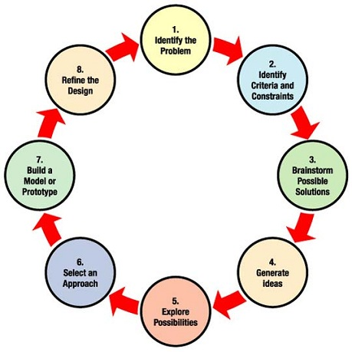
Engineering Design Process
What is the engineering design process?
A series of steps used by engineering teams to guide them as they develop new solutions, products or systems.
Steps
Define the problem
Identify criteria and constraints
Brainstorm possible solutions
Generate ideas
Explore possibilities
Select an approach
Build a prototype to test
Refine the design
➔ The process is cyclical — it is usually necessary to test and modify many times to improve your design and get it right!
Notes:
A constraint is a limitation or restriction. For engineers, constraints are the limitations and requirements that must be considered when designing a workable solution to a problem.

Slide 4
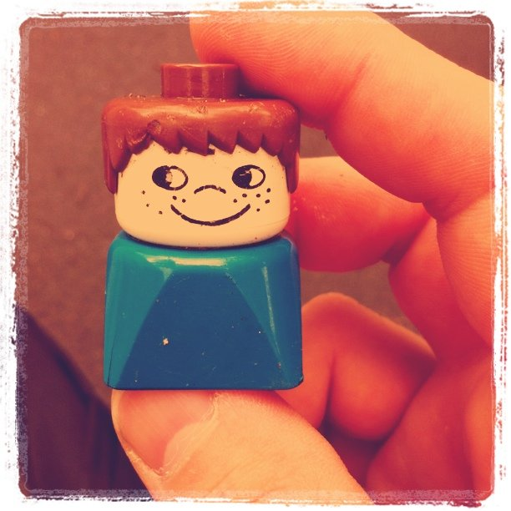
Master Driver Activity (continued)
Part 1: Testing & Calibration
Find the relationship between the number of rotations and the distance the robot travels.
To do this, try out different number of rotations in the program, and then let the robot move. Then measure the distance the robot traveled each time. Record findings on your worksheet.
Use the start line and a tape measure (or ruler) to help with testing and calibration.
Part 2: Programming & Accuracy Competition
Line up the people (action figures or LEGO people) on the finish line.
Program your robot to move from the start line to the finish line without crossing the line or hitting any figures.
One by one, groups test their programs.
Record how close each robot comes to the people and the finish line.
The group with the robot that comes closest without touching the people has the winning *best* design.

Slide 5
Track Setup and Constraints
Part 1: Testing & Calibration (without people)
measuring tape
starting point
finish line

Slide 6
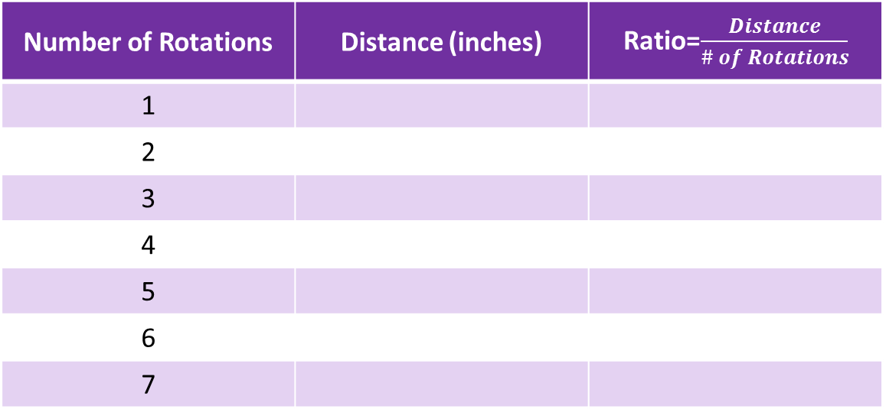
Master Driver Worksheet
Part 1: Use this chart to help you find a pattern between the number of rotations and the distance the EV3 moves.
Calculate the ratio of distance to the number of rotations for each trial. Compare this ratio for each trial. What does this tell you about the distance the robot travels for each wheel rotation?
Hint: You may find using inches easier to find the pattern.
Number of Rotations | Distance (inches) | Ratio=$\frac{Distance}{\# of Rotations}$
1
2
3
4
5
6
7

Slide 7
Track Setup and Constraints
Part 2: Programming & Accuracy Competition (with people)
toy people in a line
track length: 4 feet
measuring tape
starting point
finish line
Notes:
Distance should be 60 cm to the finish line where the people stand, but do not provide this distance measurement to the students until they complete part 1.

Slide 8
Master Driver Worksheet
Part 2
How close was your robot from the people and the finish line when it came to a stop?
For each trial, measure this distance and record your results in a chart like this:
Trial | Ending Distance from Finish Line (inches)
1
2
3
The group with the robot that comes closest without touching the people has the winning *best* design.

Slide 9
Images Sources
Slide 1: EV3 servo motor; source: LEGO Education: https://education.lego.com/en-us/products/ev3-large-servo-motor/45502
Slide 1: man waving checkered flag; source: Microsoft® clipart: http://office.microsoft.com/en-us/images/results.aspx?qu=checkered+flag&ex=1#ai:MC900229925|
Slide 2: award trophy graphic; source: Microsoft® clipart: http://office.microsoft.com/en-us/images/results.aspx?qu=winner&ex=1#ai:MC900199250|
Slide 3: Engineering design process graphic; source: NASA: http://www.nasa.gov/audience/foreducators/plantgrowth/reference/Eng_Design_5-12.html
Slide 4: hand holding LEGO person; source: Looking Glass, flickr (CC): http://www.flickr.com/photos/fernando/5224676727/sizes/o/
Slide 8: gold medal graphic; source: Microsoft® clipart: http://office.microsoft.com/en-us/images/results.aspx?qu=winner&ex=1#ai:MC900139591|

