Slide 1
Robot Sensors and Sound
Notes:
Robot Sensors and Sound Presentation > TeachEngineering.org
Day 2; expect to spend 20 minutes talking about electronic sensor types (slides 1-7) and 30 minutes for the sound sensor activity that follows

Slide 2
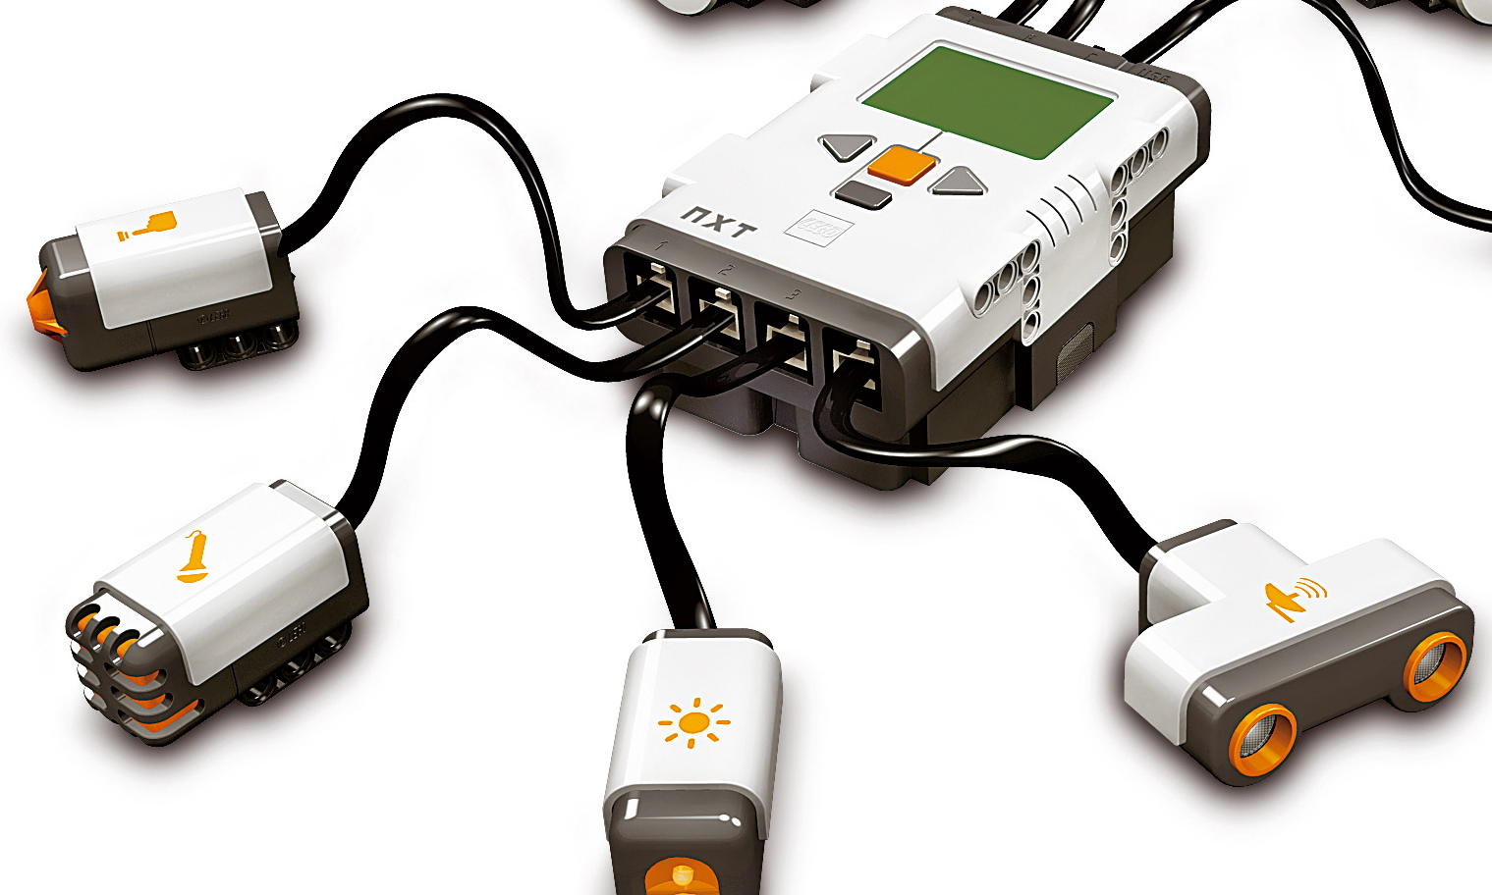
What do robot sensors do?
Gather information from the surroundings and send it to the computer (called the “intelligent brick” in a LEGO robot)
Robot sensors can only be used if the robot’s program asks for information from them!
Similarly, the robot can only act on information from the sensors if its program tells it to do so!
The sensors send information through the wires (similar to the nervous system in your body) that connect them to the computer brick, which uses the information appropriately.
How do sensors send signals to the computer brick?

Slide 3
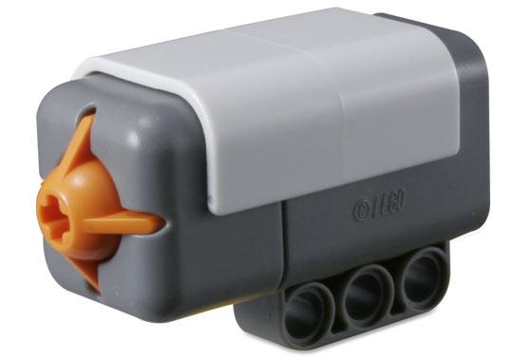
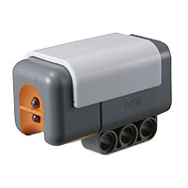
How do robot sensors work?
Touch Sensor
Button-like protrusion
When bumped, it sends an electrical signal to the computer brick via the wires saying that it has been touched
What human sense is this similar to?
Light Sensor
Detects the amount of light in front of the sensor and sends an electrical signal via wires to the computer brick

Slide 4
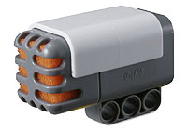
How do robot sensors work? (continued)
Sound Sensor
Our ears detect changes in pressure as sound
A sound sensor senses the changes in air pressure, and sends an electrical signal to the computer brick via the wires saying that it has heard a sound
This is similar to how a microphone senses the changes in pressure of sound (when you sing) and sends it to a speaker!
What is the equivalent human sensor and how does it work?

Slide 5
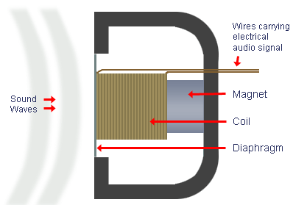
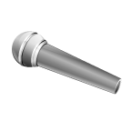
What is a microphone?
A microphone is a sound sensor similar to the LEGO sensor we just discussed. It converts sound energy to electrical energy.
The microphone below has a diaphragm that moves with sound.
This motion is converted to electricity using a magnet and coil (as you will learn later in physics and engineering).

Slide 6
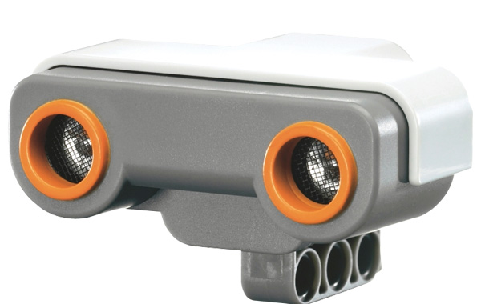
How do robot sensors work? (continued)
Ultrasonic Sensor
The sensor looks like a pair of eyes (they are not eyes!)
Imagine an object is in front of this sensor. The sensor emits a sound from one side and receives the reflection on the other side. The time it takes for the signal to reach the other side helps it estimate the distance to the object.
This is similar to how a bat estimates the distance away of objects in its path. The estimate of the distance is sent via the electrical wires to the computer brick.
You will learn more about this sensor in later lessons.

Slide 7
What are machine equivalents of human sensors?
Human Sensor | Equivalent LEGO Sensor
eyes | light sensor, ultrasonic sensor
ears | sound sensor
skin | touch sensor
smell | “electronic nose” under development; some use in industry
taste | “electronic tongue” under development

Slide 8
What Is Sound? Activity
Notes:
Expect the activity to take 30 minutes.

Slide 9
Sound Pre-Quiz
What is sound?
Can sound travel through water?
Can sound exist on the moon or in space?
What is a microphone?

Slide 10
Sound Pre-Quiz Answers
What is sound?
Sound is created by the vibration of air particles.
Can sound travel through water?
Yes. Sounds needs a medium to travel, and water can act as a medium.
Can there be sound on the moon or in the space?
Sound waves need a medium (such as air) to travel (remember the vibration of particles). There is much less air on the moon, and so we can have sound on moon. But outer space has no air, and so astronauts are not be able to hear sounds in outer space.
What is a microphone?
A microphone is a sound sensor. That is, it converts / transduces sound into electrical impulses that it sends via wires to what it is attached to.

Slide 11
What is sound?
Oscillation of air pressure is felt by humans as sound.
When air is pushed repeatedly, as by a speaker diaphragm, it creates what we call a sound wave.
Watch this video to learn more:
NASA “Science of Sound” (5 minutes)
http://www.youtube.com/watch?v=_ovMh2A3P5k

Slide 12
What is sound?
Sound is a mechanical wave:
Changes in air pressure (vibrations) produce the movement of air particles. These particles start bumping into the other air particles, and this causes a wave that travels in all directions.
Your ears can detect the wave (as shown in the video).
The mechanical energy in the wave is sensed by our ears and converted to electrical energy, which is transmitted to the auditory cortex, and our brain recognizes this as sound.

Slide 13
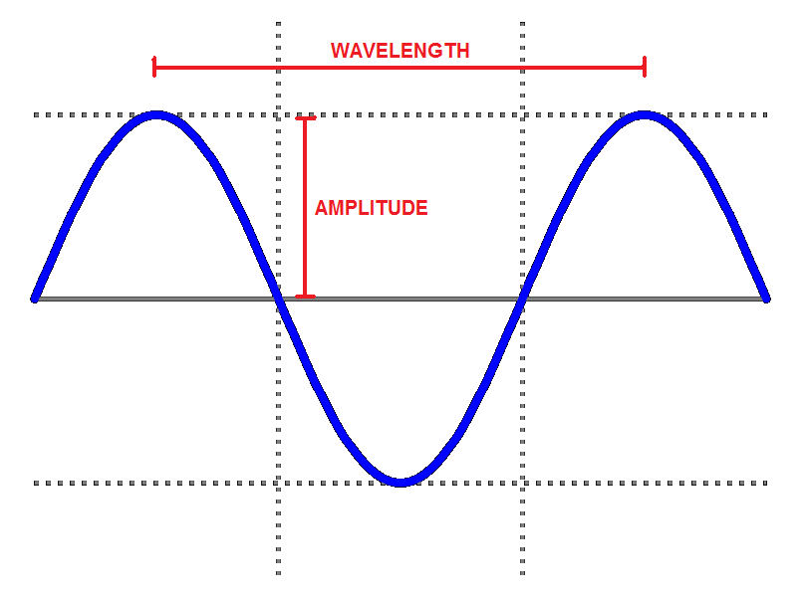
How do sounds differ?
Vibrating air is sensed as sound.
This vibration is like a wave, as shown to the right.
The “loudness” or intensity of sound is measured in decibels (dB), and is related is related to its amplitude. The higher the amplitude (higher its dB), the louder it sounds.
The pitch of the sound is its frequency, that is, how many waves happen in one second (see the next slide).
The higher the pitch, the more shrill it sounds.

Slide 14
More about sound
Wavelength is the distance between any two successive “peaks” on the wave.
Period is the time required for one complete cycle of the vibration.
Frequency of the sound is the inverse of period, that is, frequency = 1/period.
Amplitude is the height of the wave. A loud sound has a high amplitude and soft sound has a lower amplitude.

Slide 15
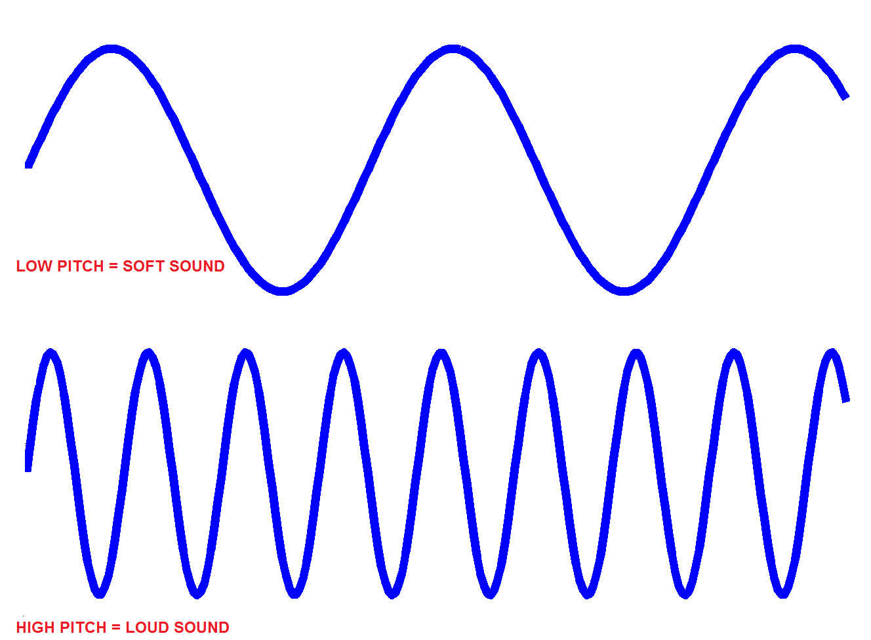

Slide 16
To the experiment!
Although you cannot “see” sound, you can record it and study its properties.
In this experiment we are going to use the microphone port in a computer (to capture your voices and other sounds) and software that transforms the electrical signal from the microphone into a waveform.
Sound waveforms are like the rings of waves formed when you throw a stone into a still body of water ➔

Slide 17
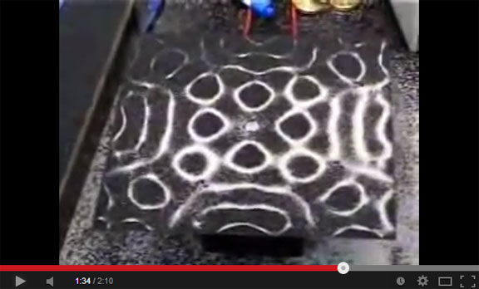
Seeing Sound
Watch these additional optional videos:
Acoustic water dance; water on speaker (4:44 minutes)
http://www.youtube.com/watch?v=tI6S5CS-6JI
Seeing sound waves at different pitches (2:10 minutes)
http://www.youtube.com/watch?v=s9GBf8y0lY0

Slide 18
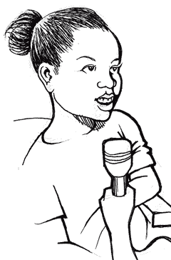
Activity Setup
A microphone is a sound sensor that converts sound to an electrical signal, which can then be displayed on a computer screen.
Notes:
Expect the activity to take ~30 minutes.

Slide 19
Activity Setup (continued)
Your voice is a complex sound wave that contains lots of different pitches (frequencies). Boys and girls have different pitches in their sounds.
Irregular repeating sound waves create “noise,” while regular repeating waves seem “musical” to our ears and brain.
In this activity, you will learn more about the properties of sound waves.

Slide 20
Sound Worksheet
What were your observations when you generated sounds with 50, 100, 200, 500, 800,1000, 10000 Hz frequencies and played them?
How do “tone” and “noise” differ in their waveforms and how they sound?
Tap in/on the desk below the computer and see what sound is captured by the microphone. What do you observe?
Try singing the solfege notes (do-re-mi-sol-la-ti) one at a time, for 5 seconds each. What do you observe?
Try speaking the same word (like “hello”) in three different tones (whisper, normal and loud). What are the main differences between the waveforms?

Slide 21
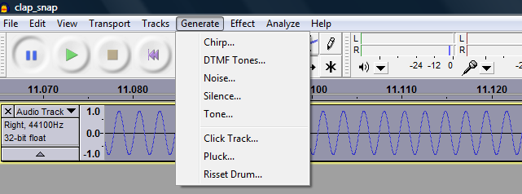
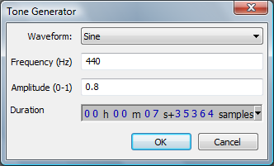
Activity Instructions (Using Audacity®)
We are using a free, open-source software called Audacity to record and edit sound files.
Start Audacity on your computer > go to File > select New to open a file to record sounds.
Begin by using Audacity to generate waves and see what they sound like when played.
Go to Generate > from its options, select Tone. For this tone, select a frequency and amplitude. Pick frequencies of 50, 100, 200, 500, 800,1000, 10000 Hz, and leave the amplitude as 0.8. Zoom in and note your observations. To delete any record, go to Edit > Remove Audio > Delete.
Notes:
Audacity® is free, open source, cross-platform software for recording and editing sounds.
http://audacity.sourceforge.net/

Slide 22
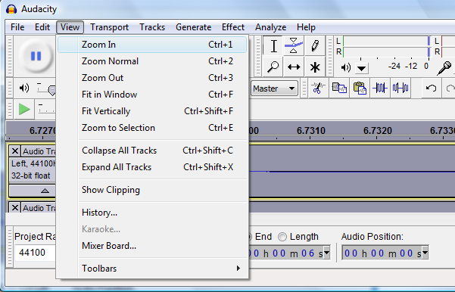
Activity Instructions (Using Audacity)
Under the View menu, click Zoom In until you get a clear view of the waveform.
You may need to do this several times until you see waves like those shown here.
Notes:
Audacity® is free, open source, cross-platform software for recording and editing sounds.
http://audacity.sourceforge.net/

Slide 23
Activity Instructions (Sounds Generated by Software)
Now try different waveforms than sine, and also try increasing the amplitude. What do you observe?
If you want to delete what you have recorded, go to Edit > Remove Audio > Delete.
Go to Generate and from its options > select Noise and check what that sounds like. Then try the others, such as Chirp.
Again, record your observations on the worksheet.
Notes:
Audacity® is free, open source, cross-platform software for recording and editing sounds.
http://audacity.sourceforge.net/

Slide 24
Activity Instructions (Sounds Generated by You)
Next, record your own voice and see what the waveform looks like.
Either delete the wave in your present file, or open a new project file: go to File > New
To record your own voice using the microphone, click on the circular red button (record button) on the playback toolbar, say “hello” and see what is being recorded.
After you record it, play it back using the play button on the control panel shown below.
Record your voice using the red “Record” button
Notes:
Audacity® is free, open source, cross-platform software for recording and editing sounds.
http://audacity.sourceforge.net/

Slide 25
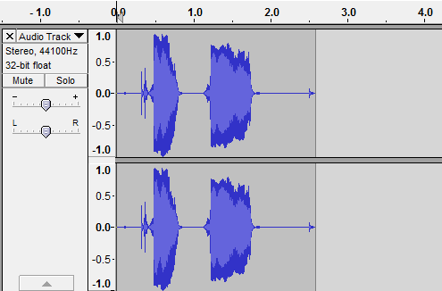
Activity Instructions (Sounds Generated by You)
Press Record and say some words (like “hello”) to see the resulting waveforms.
Then play back what you recorded to see if it sounds like what you recorded.
The recorded wave form should look like this 
TIP: To get a better look at the frequencies and amplitudes, click on View > Zoom In. You may need to keep on clicking several times (6-10x closer) to get a clear view of the waveform that goes up and down. It should look like the one in the figure.
Use the slider at the bottom to browse through the entire wave.
As you can see, the recorded sound has variable amplitudes and multiple frequencies, compared to previously “generated” waves with fixed amplitude and frequency.
All sounds are waveforms with frequencies and amplitudes! Complex sounds have many frequencies of different amplitudes. This is true of your own sounds.
Notes:
Audacity® is free, open source, cross-platform software for recording and editing sounds.
http://audacity.sourceforge.net/

Slide 26
Sound Post-Quiz
What is sound?
What is the difference between a loud sound and a soft sound in terms of pitch?
Draw sound waves for high-pitch and low-pitch sounds.
When you hum the same note continuously, does it produce a distinguishable waveform? How about when you scream?

Slide 27
Sound Post-Quiz Answers
What is sound?
Sound is created by the vibration of air particles.
What is the difference between a loud sound and a soft sound in terms of pitch?
They differ primarily in amplitude and not pitch (frequency).
Draw sound waves for high-pitch and low-pitch sounds.
A high-pitch sound has more waves per unit time, compared to a low-pitch sound. (See slide 15 for an example drawing.)
When you hum the same note continuously, does it produce a distinguishable waveform? How about when you scream?
A note usually is close to a “sine” in form, while a scream has lots of frequencies.

Slide 28
Vocabulary
olfactory: Related to smell.
sensor: A device that converts one type of signal to another; for instance, the speedometer in a car collects physical data and calculates and displays the speed the car is moving.
ultrasonic: A sound of a frequency that humans cannot hear, but dogs and bats can.
peripheral: Surrounding.

Slide 29
Image Sources
Slide 1: three girls yelling; source: Microsoft® clipart: http://office.microsoft.com/en-us/images/results.aspx?qu=yelling&ex=1#ai:MP900439297|
Slides 2, 3, 4, 7: LEGO parts; source: LEGO MINDSTORMS NXT User’s Guide
Slide 5: microphone; source: Microsoft® clipart: http://office.microsoft.com/en-us/images/results.aspx?qu=microphone&ex=1#ai:MC900433836|
Slide 5: Cross section of dynamic microphone; source: Total Venue: http://www.totalvenue.com.au/articles/microphones/microphones.html
Slides 13, 14, 15: wave lines and graphs by the author
Slide 16: water nodal lines; source: Microsoft® clipart: http://office.microsoft.com/en-us/images/results.aspx?qu=water&ex=1#ai:MP900402205|
Slide 17: sand shapes from sound waves; source: pulled from YouTube Seeing Sound Waves video: http://www.youtube.com/watch?v=s9GBf8y0lY0
Slide 18: girl, microphone, sound waves by author using clipart
Slides 21, 22, 24, 25: screen capture images by author

