Slide 1
Insulator Design Challenge

Slide 2
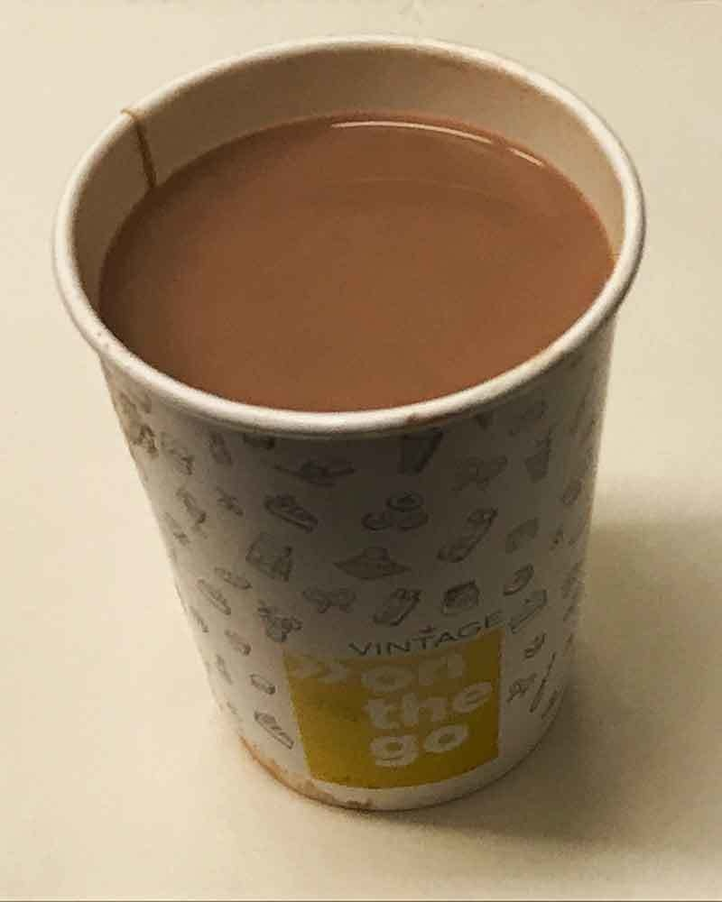
Do Now
You have a cup of hot chocolate on a cold day. Draw a diagram of the cup and label where heat transfer would occur. Draw where you add something to keep the hot chocolate warm.
Word Bank for labels
- insulator - conductor – heat - lid
- hot chocolate - cup – outside - inside
- transfer – sleeve - cover
Cup of hot chocolate

Slide 3
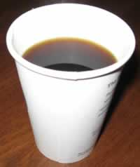
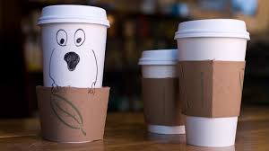
Insulator Design Challenge
Your challenge is to design and build an insulator with a paper cup and other materials to keep water hotter than the other groups in your class!
You have one class period to work on this.
Cup of hot chocolate

Slide 4
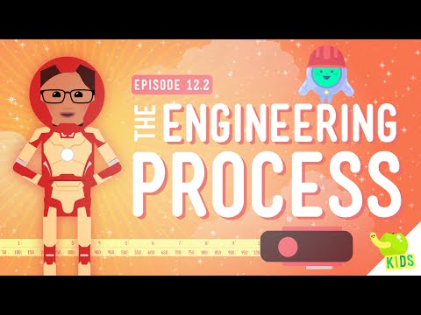
Engineering Turn and Talk
What is the problem we are trying to solve?
Which steps will we be using in this project?

Slide 5
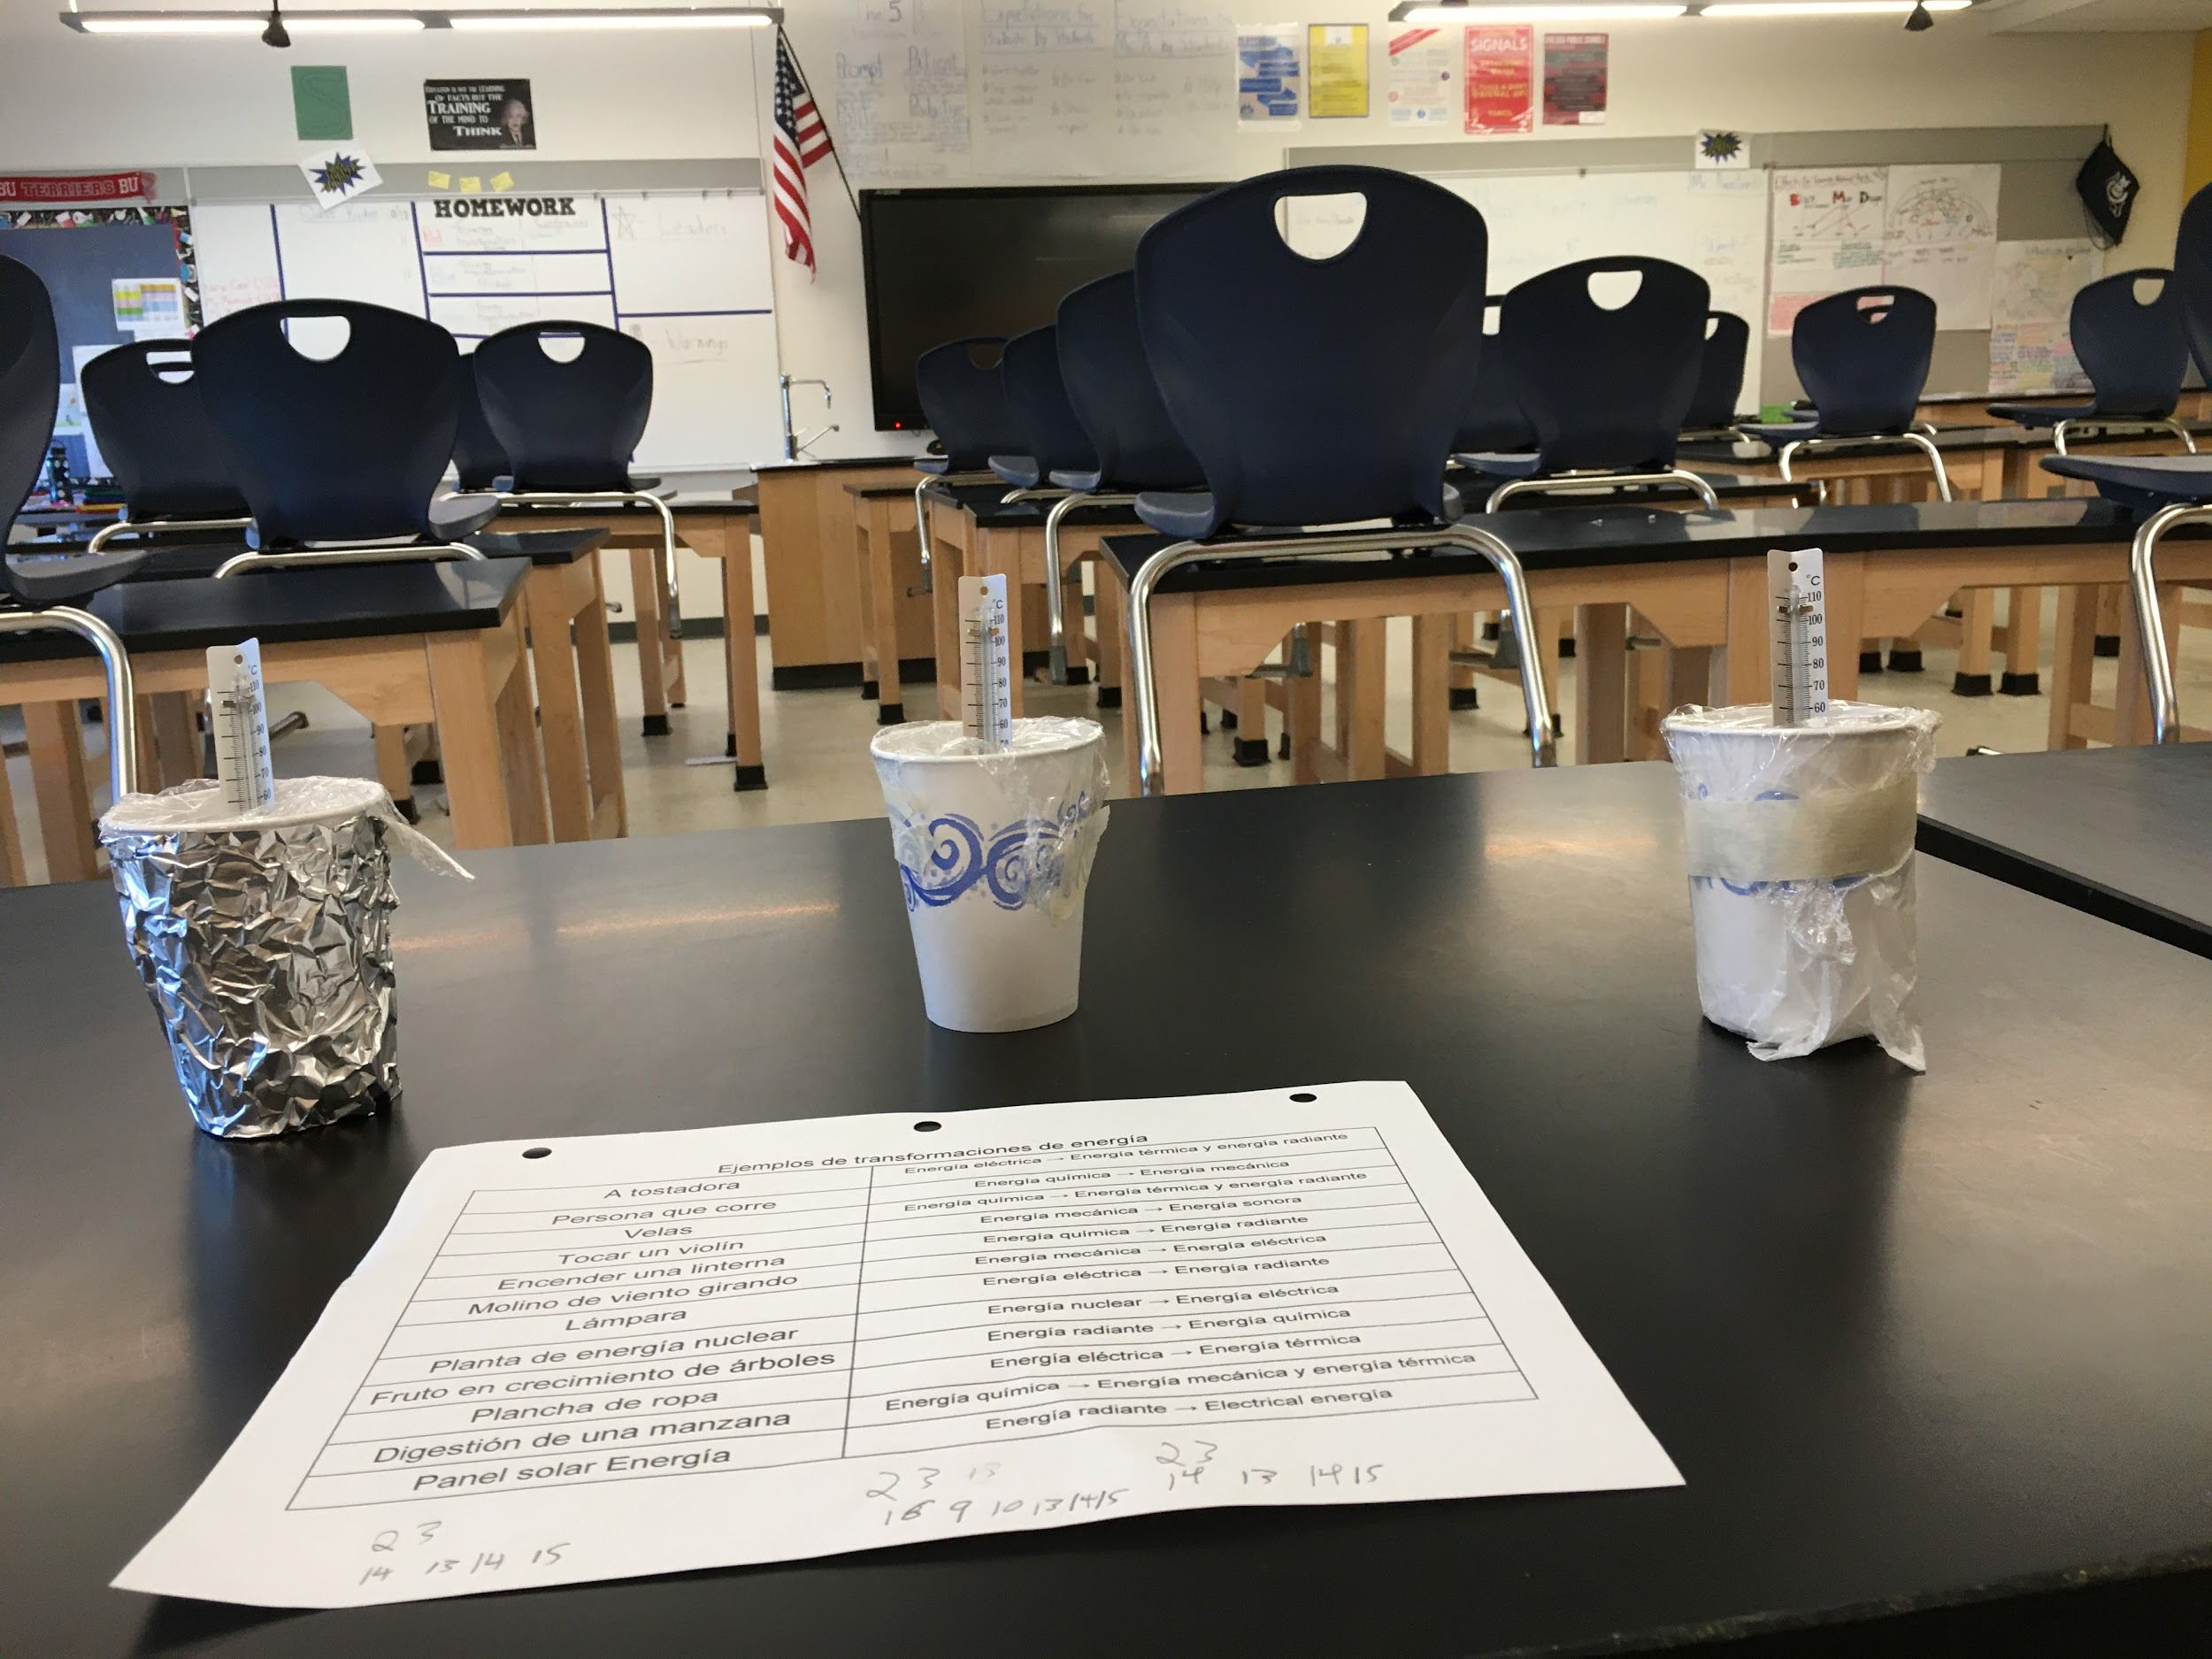
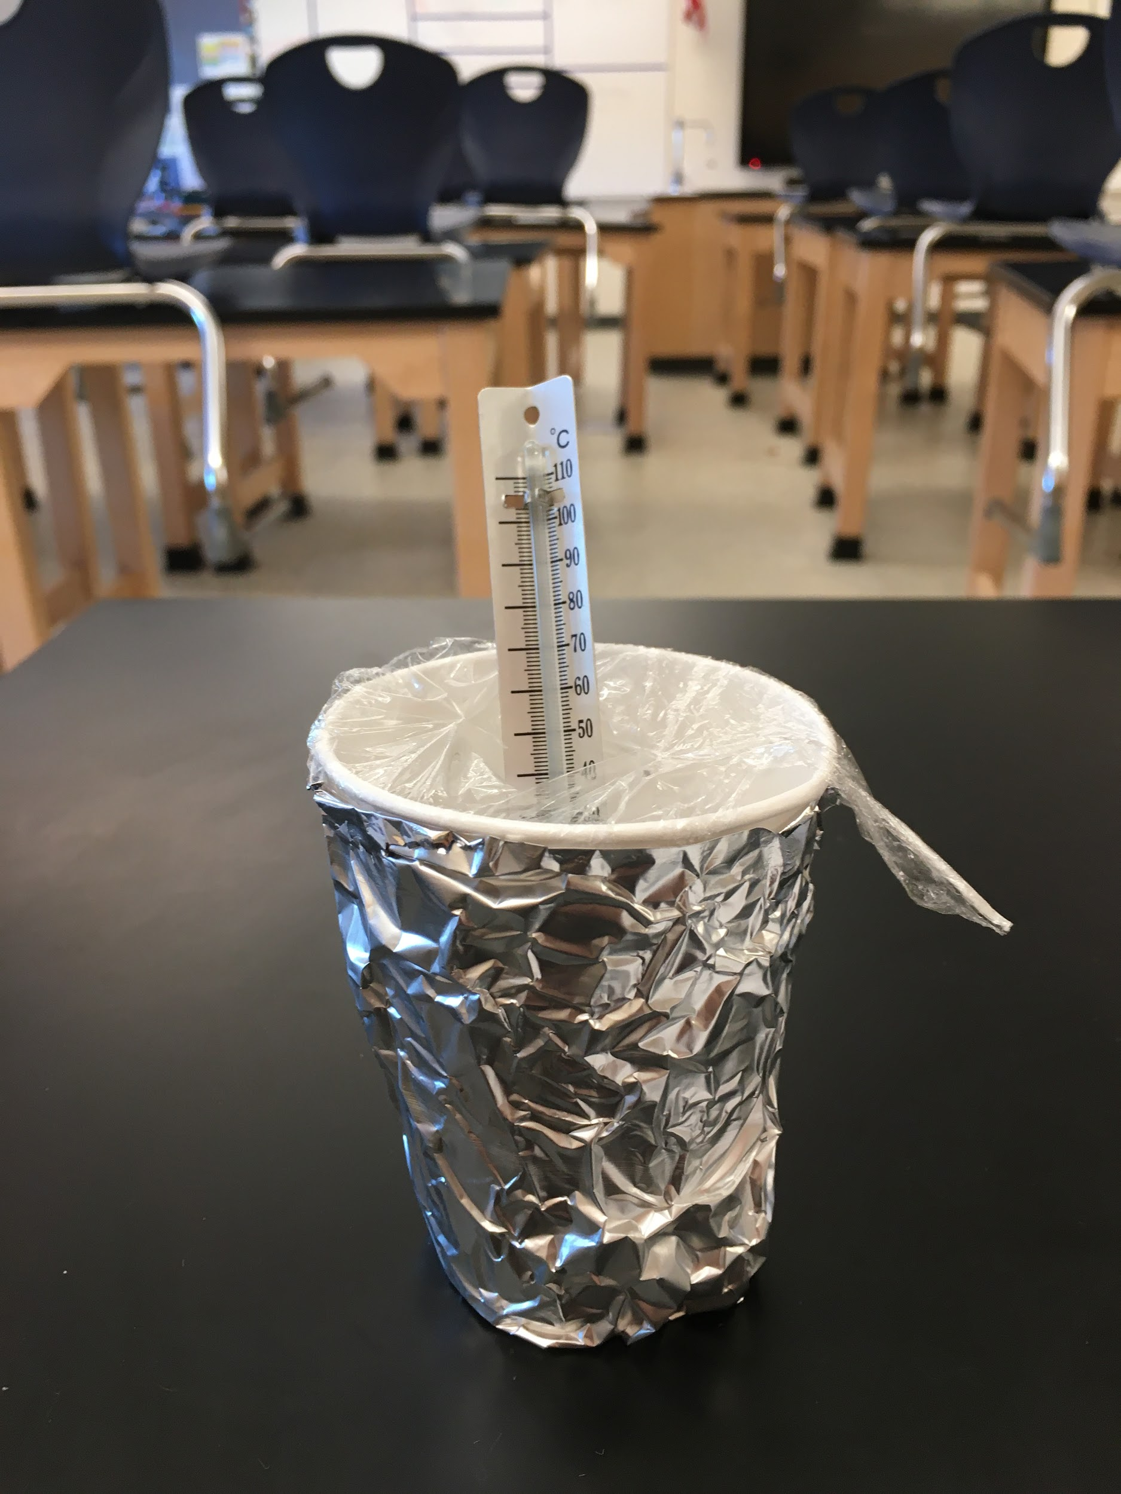
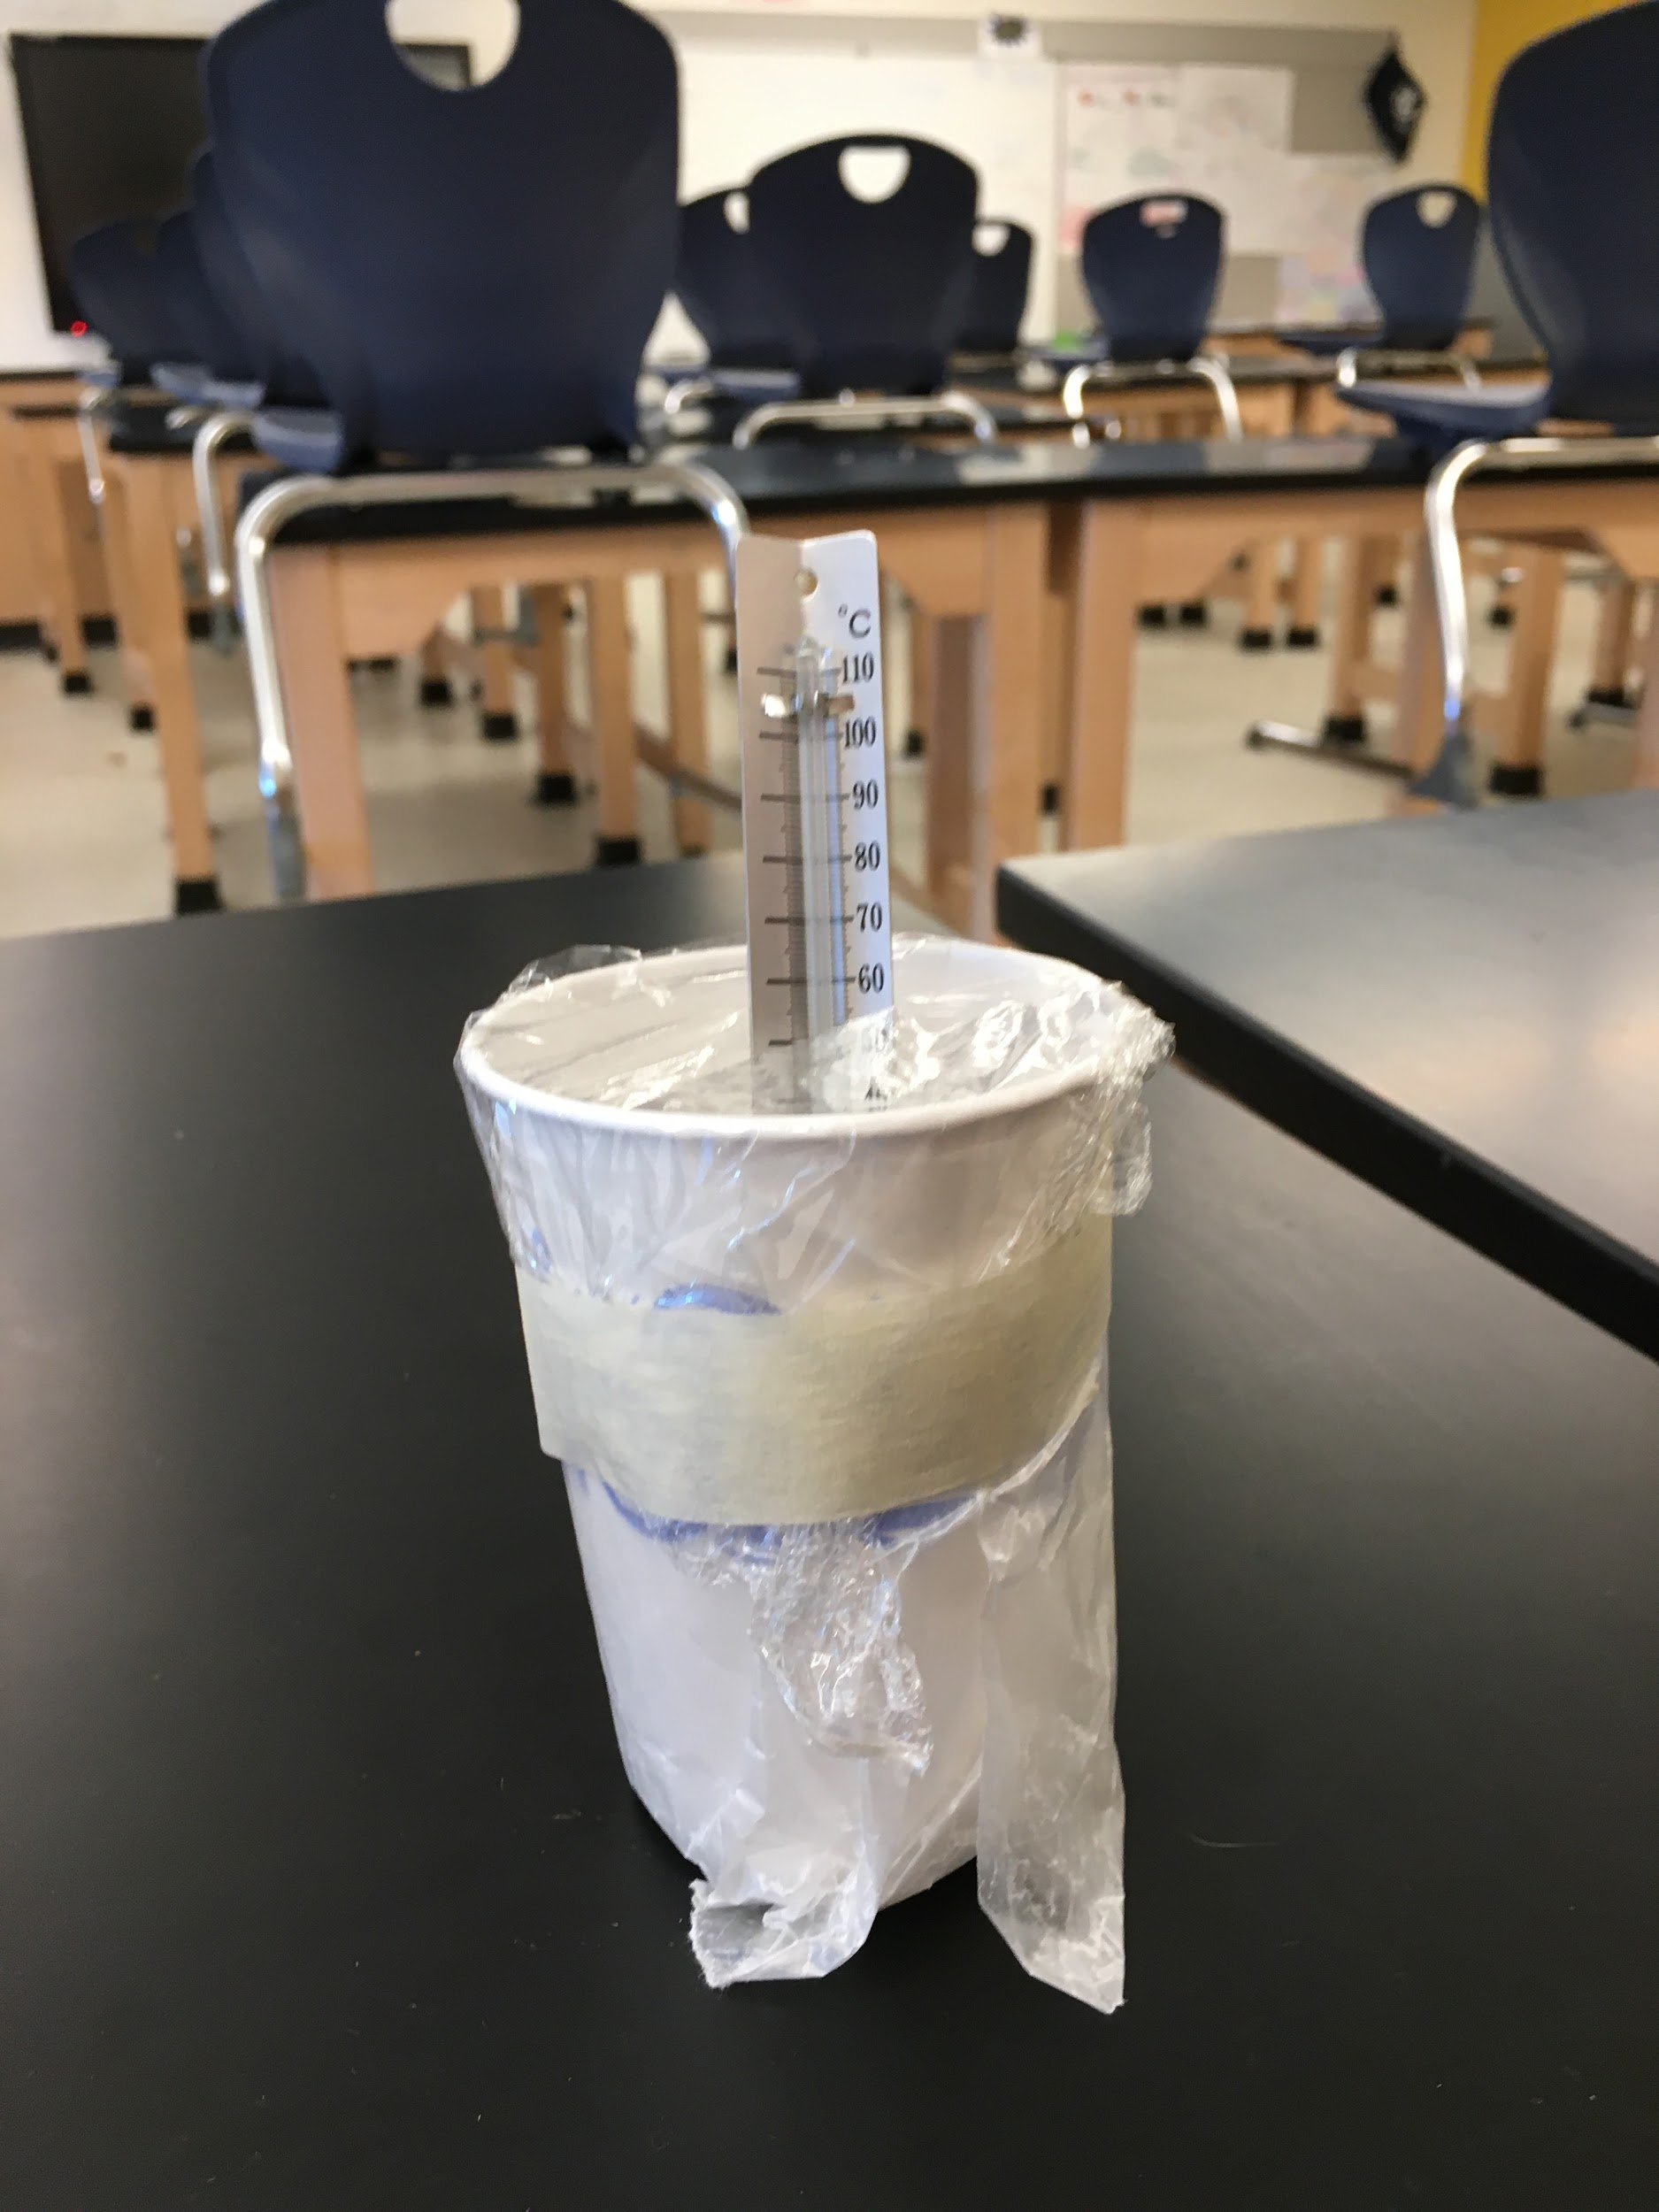
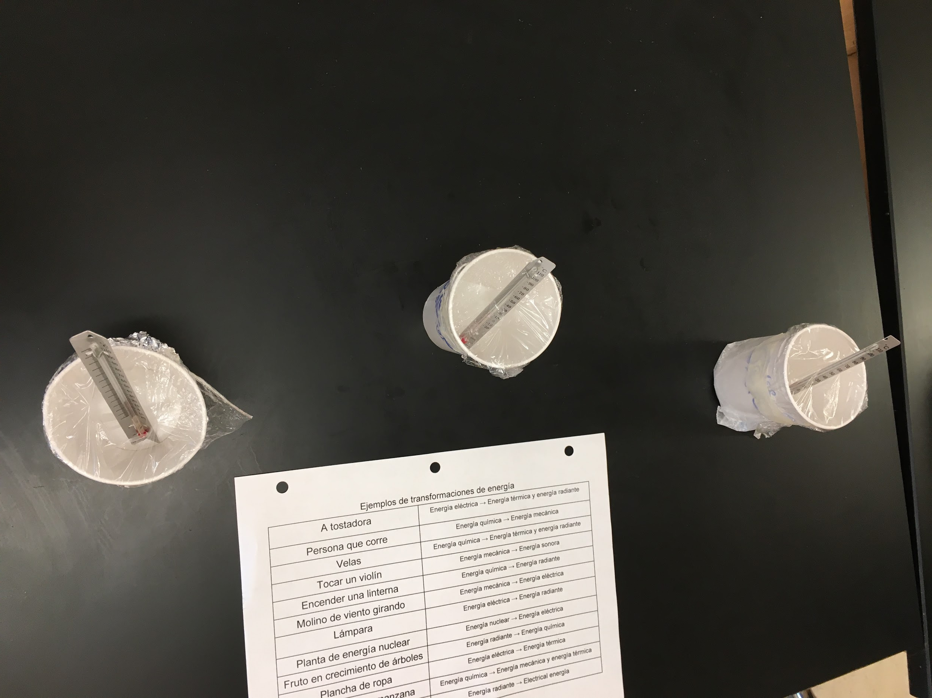
Examples

Slide 6
Getting Started
With your engineering group...
Complete the questions on the first page.
What will you do to keep the water hot?
What materials will help you keep the water hot?
2. Draw a diagram to design your insulator and show the
heat flow.

Slide 7
Do Now
In our insulator design challenge, what is the problem we are trying to solve as engineers? What are we doing to solve it? What is an insulator?
The problem we are solving is…
Word Bank for labels
- insulator - heat - cold - transfer - loss
- prevent - minimize - hot
Cup of hot chocolate

Slide 8
Examples

Slide 9
Lab Summary
You will design, construct, test, and evaluate a device (insulator) to minimize heat transfer.
Need to know:
Graded as Performance Task
Keep items on desks
No eating, throwing, or misusing materials

Slide 10
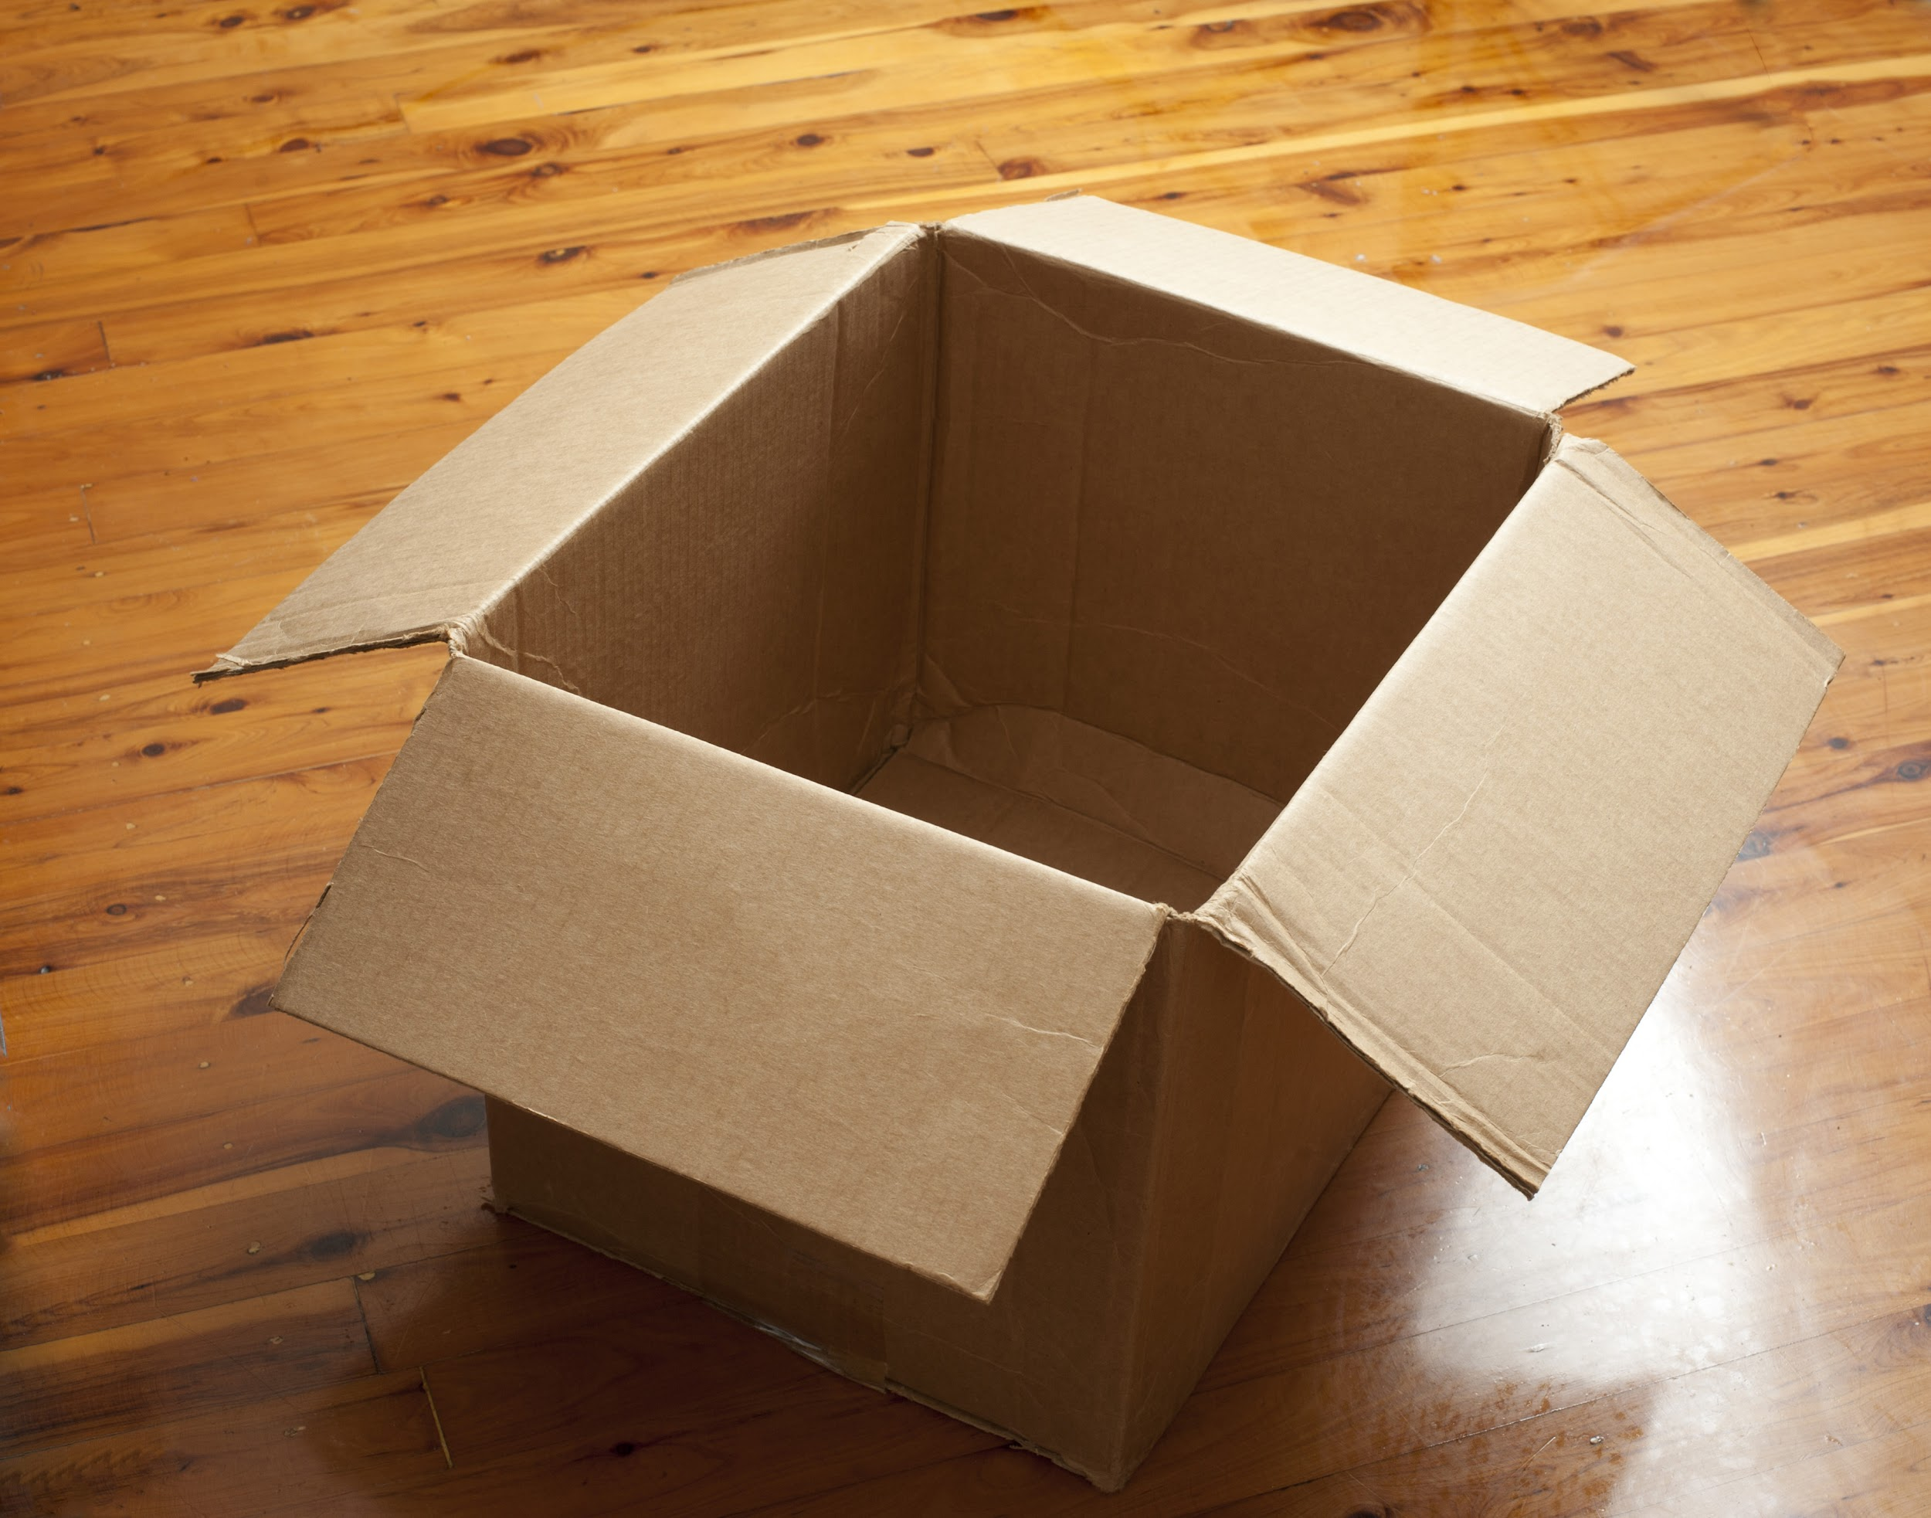
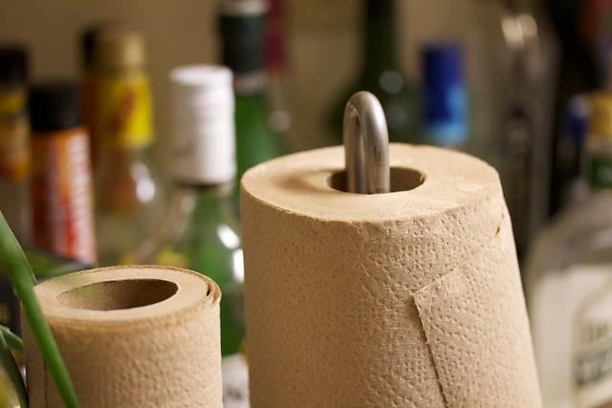
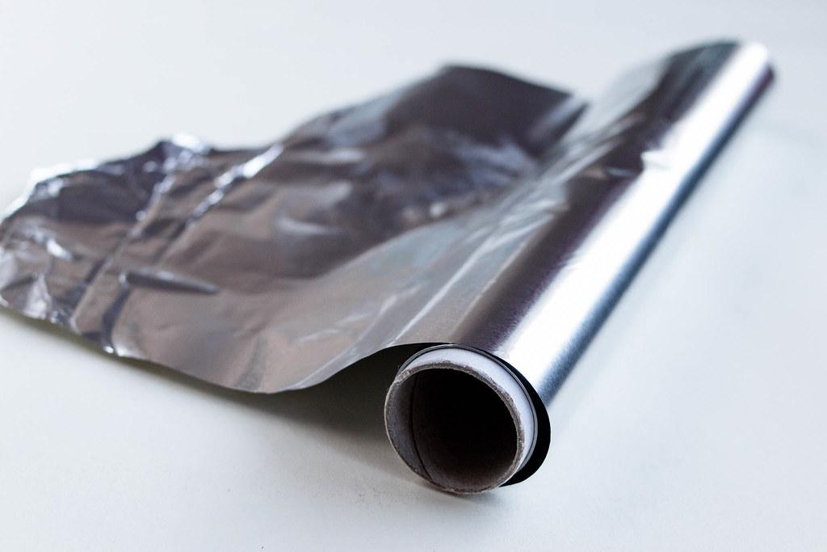
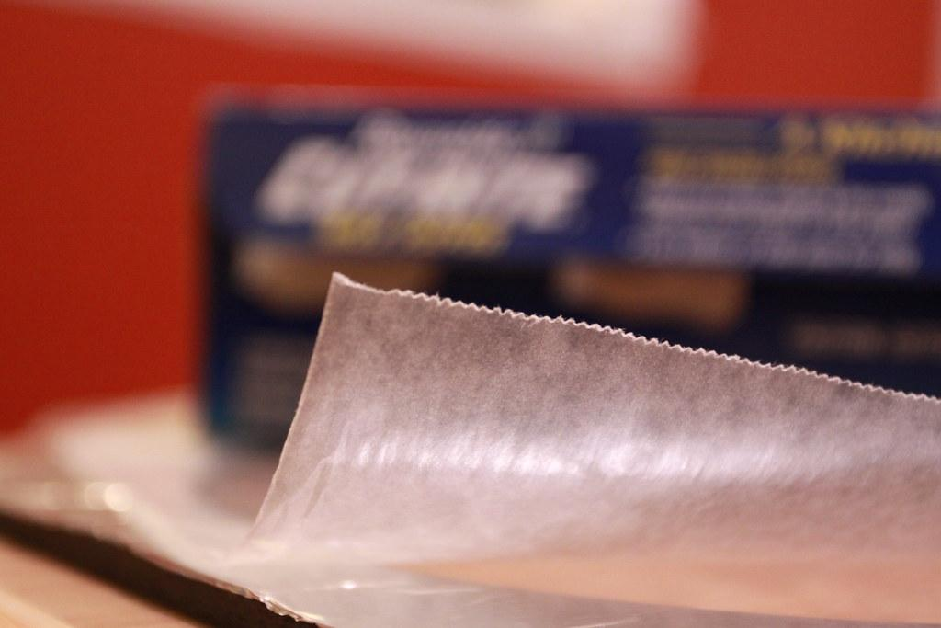
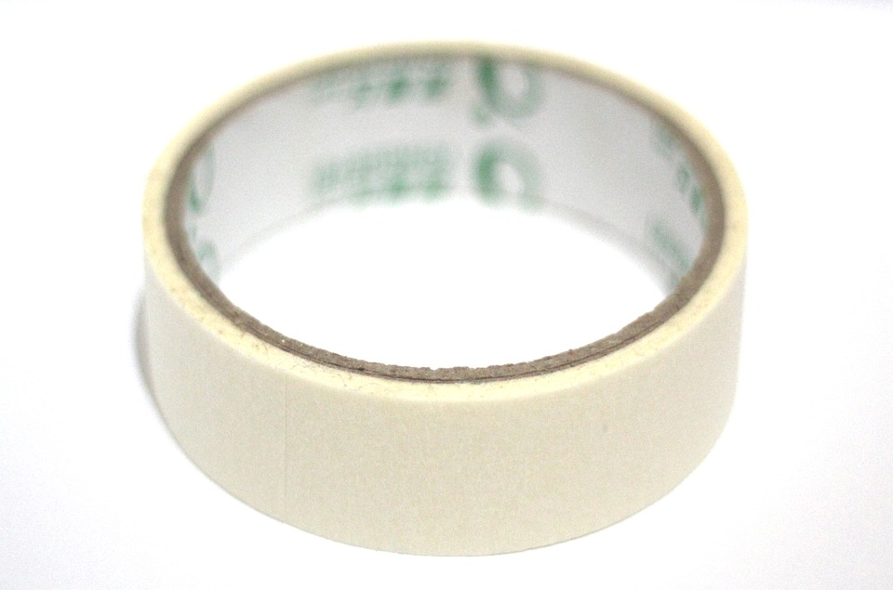
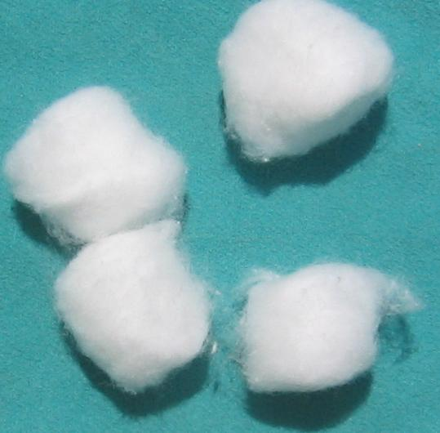
Materials You Can Use
paper towel
cardboard
wax paper
aluminum foil
cotton balls
masking tape

Slide 11
Getting Started
With your engineering group…
Complete the questions on the first page.
What will you do to keep the water hot?
What materials will help you keep the water hot?
Draw a diagram to design your insulator and show the heat flow.

Slide 12
By the End of Class…
You should have:
Completed the first page of worksheet: Questions & Diagram.
Finished building your insulator.
Your insulator can have a lid, a plate, and/or a wrapping.

Slide 13
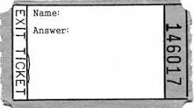
Exit Ticket
What is something you are unsure about in your insulator design?
I don’t know if…
I’m wondering if _______ is the best material for the...
Word Bank
- plastic wrap - cap
- masking tape - sleeve
- aluminum foil - - cardboard
- paper towel
- wax paper

Slide 14
Do Now
How will we know if our insulator is successful? Draw a diagram or write two sentences.
Our insulator will be successful if…
Word Bank
- temperature
- water
- heat
- thermometer

Slide 15
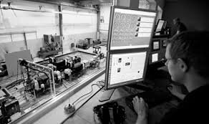
Tasks for Running Insulators
Lid of cup needs to be removed.
Need to be able to read thermometer in water.
Using stopwatch, take temperature of water in cup every minute for 10 minutes and write down on sheet.
Finish first page of worksheet.

Slide 16
Exit Ticket
How effective was your insulator? Give one reason.
Our insulator was effective because…
Word Bank
- temperature
- heat
- inside
- outside
- materials

Slide 17
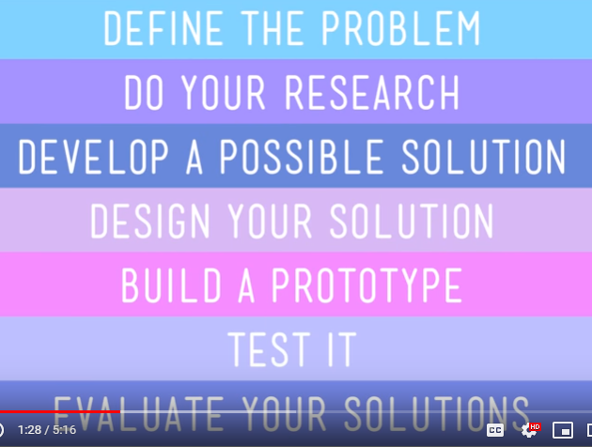
Do Now
Choose two steps of the engineering process and write two sentences to explain how we did those steps.
Word Bank
-Temperature
-Heat
-Inside
-Outside
-Materials

Slide 18
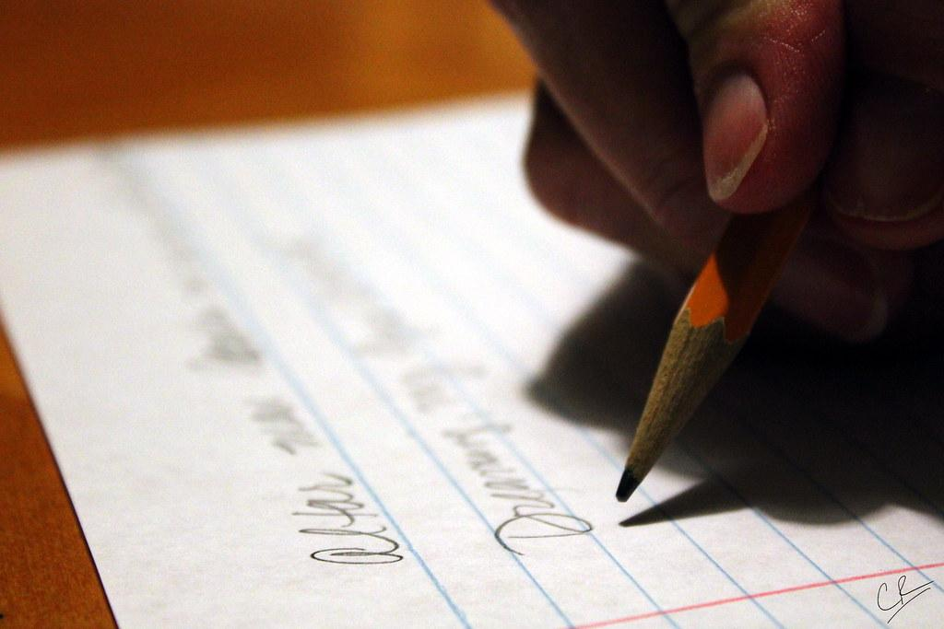
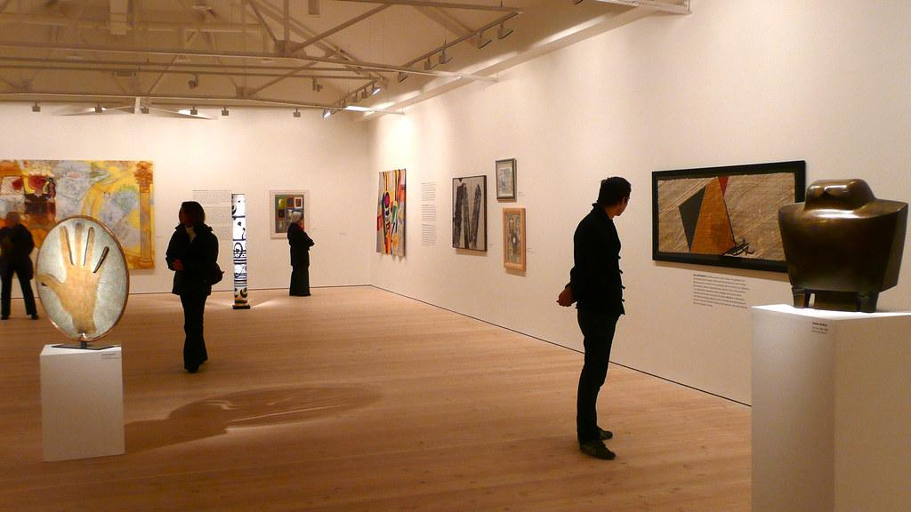
Tasks for Lab Wrap-Up
Subtract highest and lowest temperature for total temperature change.
Write names, temperature change, materials, & structures on whiteboard.
Determine which group(s) won.
Conduct gallery walk to see other groups’ insulators.
Finish the first page of the worksheet.
Contest Results: “My group” & “one other group”

Slide 19
Insulator Design Challenge and Reflection
Task: Write a five-sentence reflection about our insulator engineering project.
Word Bank: temperature, heat transfer, thermal energy, degrees, insulator, conductor, materials, engineering
I built an __________ insulator for my cup and my evidence is…
One thing that went well during my insulator engineering project is…
One thing that I would change how I built my insulator is…
…(fourth sentence) …(fifth sentence)

Slide 20
Exit Ticket
Write one sentence to describe how you felt about doing our engineering insulator design project.
Word Bank
- difficult – easy – fun
- interesting - confusing
- uncomfortable - annoying
- helped me learn
- do more/less engineering

